Slide 1
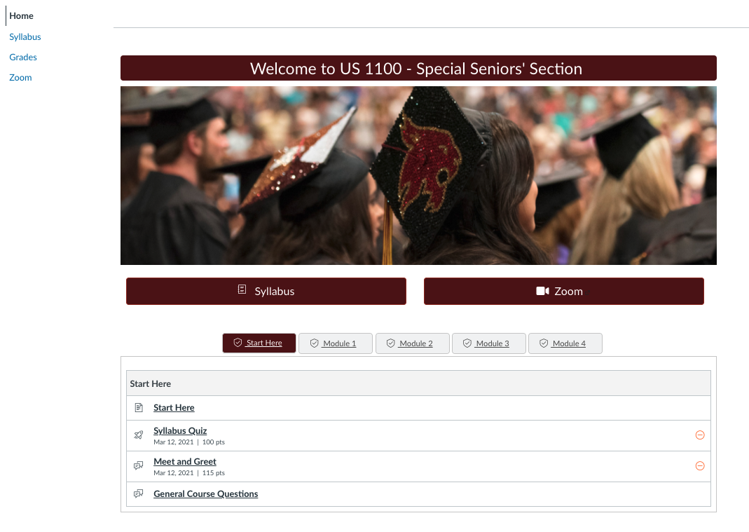
Sample Home page
Client: DELSAC -- Student Experience Focus Group
Status: Complete
Audience: Students who have taken online courses at Texas State University.
Description: These templates were created to demonstrate various possible course structures to students in order to get feedback.
Student View –
This homepage is purposefully simple containing each course module on the front page so students can easily see each completion status. Only shortcuts to the course Syllabus and Zoom are provided. Grades is also accessible via the left navigation panel.
Students are required to pass the Syllabus Quiz in the Start Here module before going on to the other module activities and additional modules.
Based off – Dr. Read’s course.

Slide 2
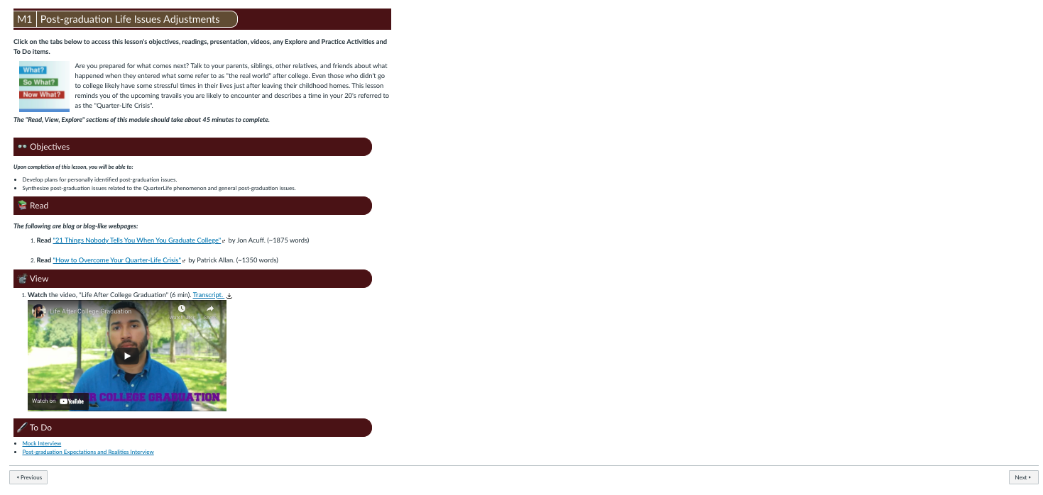
Single-page lesson layout
Student View –
Example Lesson plan within the same course. This is referred to as a single-page Lesson.
Students can use the Next button to proceed in ‘order’.
Based off – Dr. Read’s course.

Slide 3
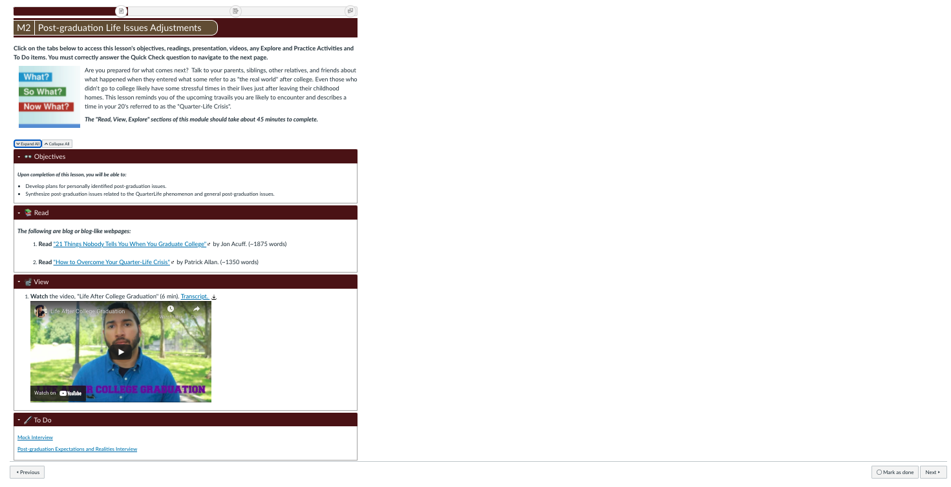
Single page lesson layout with expanders
Student View –
Example Lesson plan within the same course. This is referred to as a single-page Lesson - Expanders. The Objectives, Read, View, and To Do sections are contain content and links, but can be collapsed to reduce overly long pages as desired by the student.
Students can use the Next button to proceed in ‘order’. Note students must mark this page as complete in order to gain access to future pages
Based off – Dr. Read’s course.

Slide 4
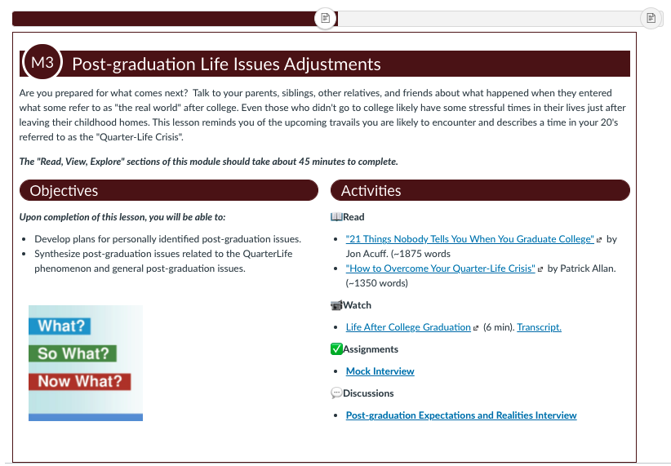
Single page lesson sample with 2 columns
Student View –
Example Lesson plan within the same course. This is referred to as a single-page Lesson – 2 columns. Objectives always appear on the left, while Read, Watch, & Assignment are provided as links only on the right side.
A ‘Wrap-up’ checklist follows this page. The Module lineup (unseen to students in this example_, does not contain the assignments as line items, meaning the page navigation at the top will not include them.
Students can use the Next button to proceed to the Wrap Up page.
Based off – Dr. Read’s course.

Slide 5
Example assignment page
Student View –
Example Assignment page with the assignment purpose provided along with steps for completion. The assignment utilizes a Flipgrid integration. A rubric is included.
Based off – Dr. Read’s course.

Slide 6
2 page lesson example, pg 1
Student View –
Example Lesson page within the same course. This is referred to as a 2-page Lesson – Content Tabs. A lesson introduction and Objectives always appear on on the first page. When students click Next, they are taken to Read, View, Explore activities, and a Quick Check.
Based off – Dr. Read’s course.

Slide 7
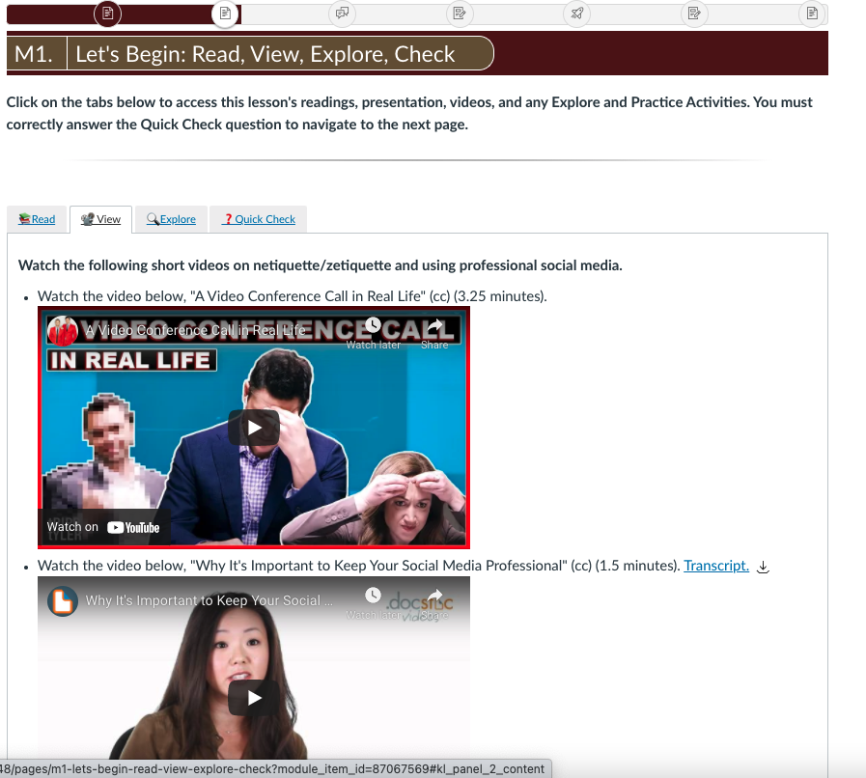
2-page lesson sample, pg 2
Student View –
The Read, View, Explore, Check page is the second Lesson page in any module. Students click on the tabs to access links and embedded items.
Based off – Dr. Read’s course.

Slide 8
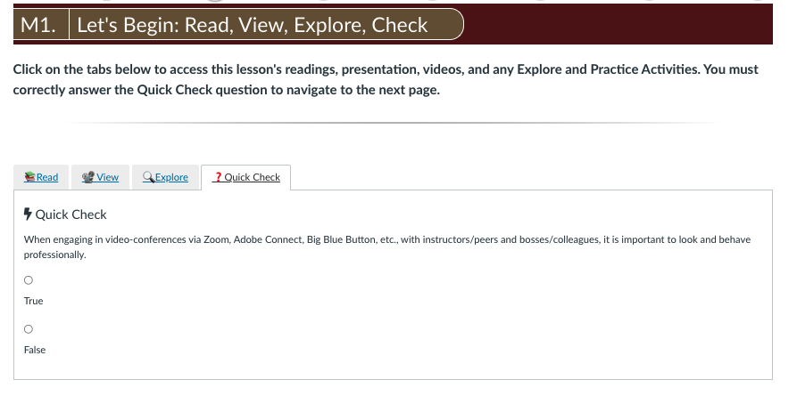
Quick Check
Student View –
The Read, View, Explore, Check page always contains a Quick Check question which forces students to answer correctly before they can move on to the next graded items in the module lineup.
Note the navigation bar at the top allows students to access any item in the module.
Based off – Dr. Read’s course.

