Slide 1
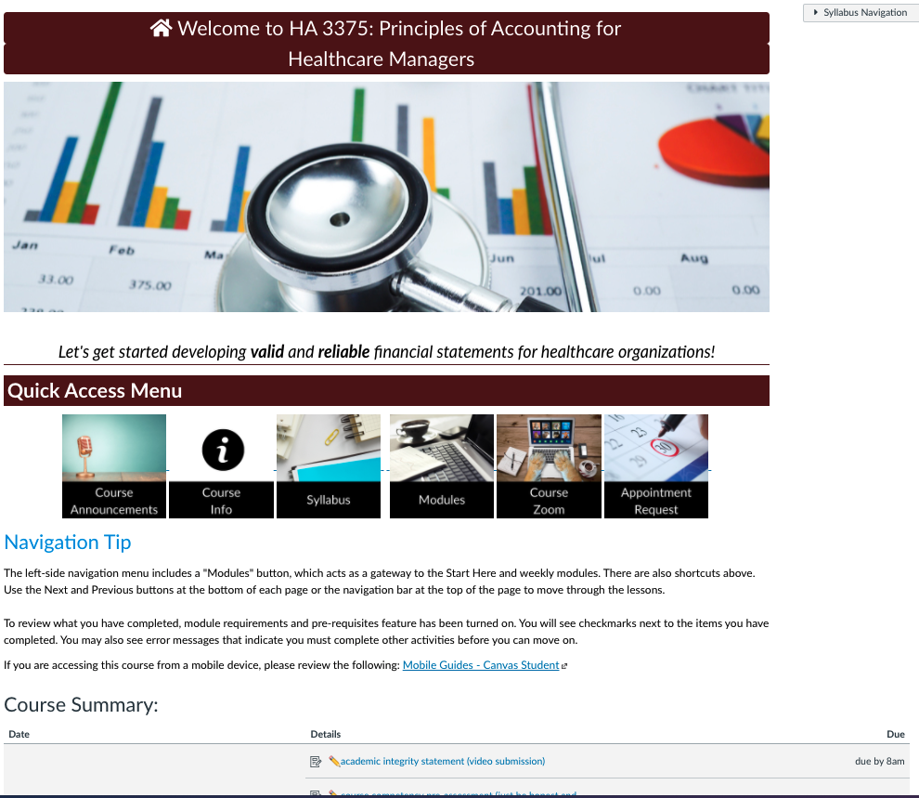
Home page
Client: HA 3375 – Principles of Accounting for Healthcare Managers; Cristian Lieneck, SME
Status: Complete, waiting for initial run
Audience: Students needing this course to graduate from their program
Description: F2F course with online lab-like weeks
Homepage –
This homepage utilizes quick link icons and uses the syllabus page as the front page so that the Course Summary with links to assignments can be provided upfront.

Slide 2
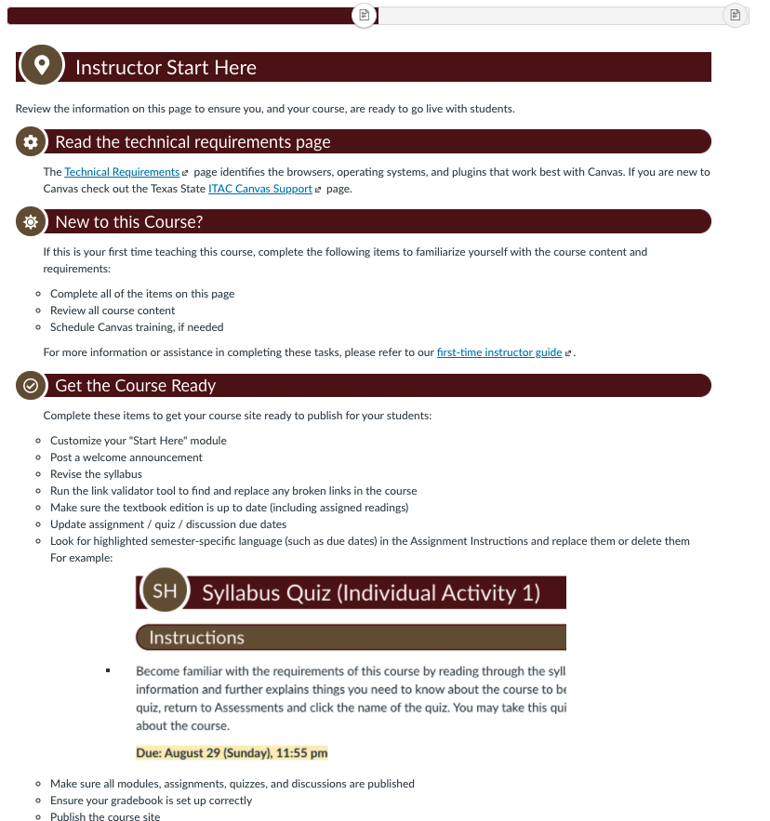
Instructor Start Here page
Instructor Start Here –
This unpublished page (hidden from students) alerts instructors on what exactly they need to do to set up the course. Because this instructor likes to put due date information directly in the Assignment instructions, they will have to be updated each time the course is run.

Slide 3
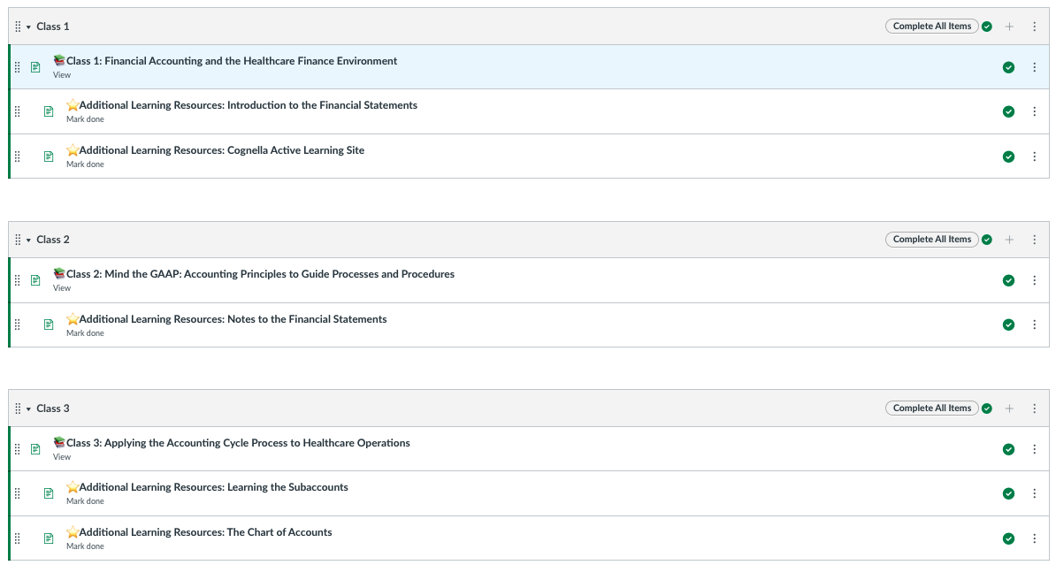
Modules page 1
Module page –
Each module contains pages which must be “Marked as Done” so that students and the instructor can very clearly see that each page has been reviewed.

Slide 4
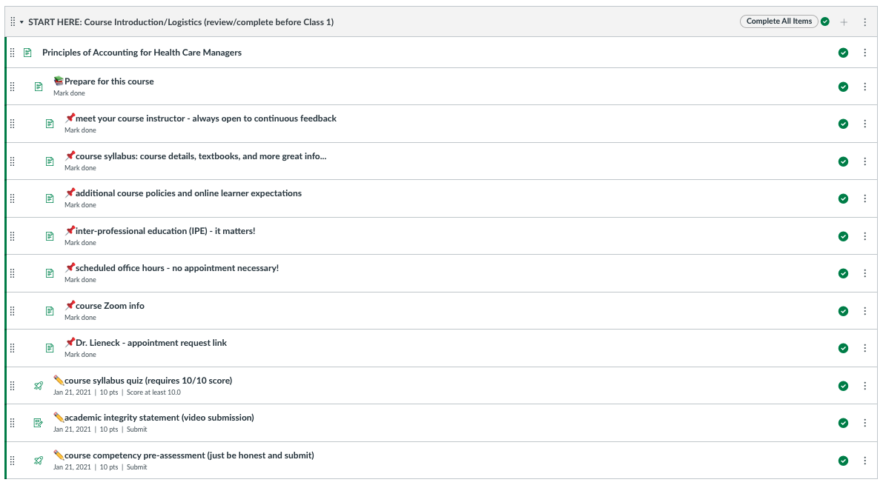
Modules page 2
Student Start Here –
Students prepare for the course by addressing items in this Start Here module before coming to the first class meeting.
Note students must ”Mark as Done” certain pages.

Slide 5
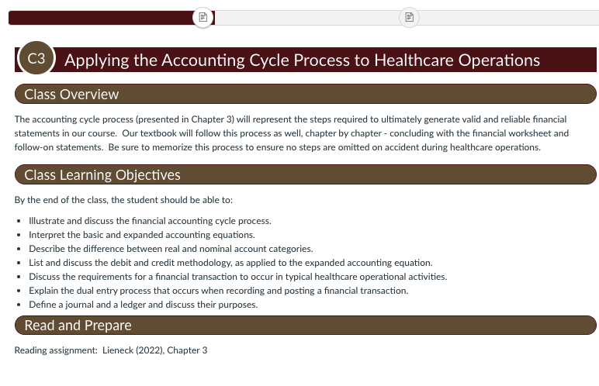
Typical First Lesson Page
Standard first page in a lesson module --
The initial lesson page contains the overview, objectives and Read and Prepare section.

Slide 6
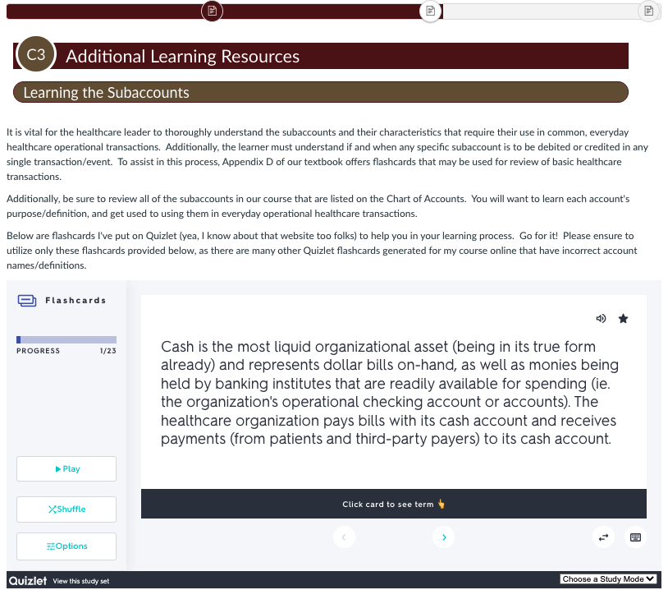
Typical Second Lesson Page sample - Quizlet
Additional Learning Resources --
We included embedded Quizlet activities for studying terms.

Slide 7
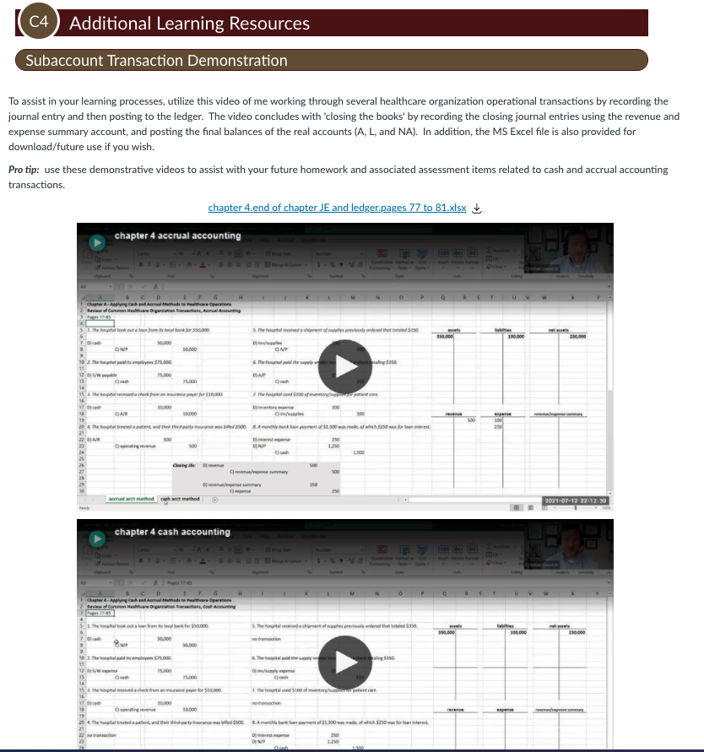
Typical Second Lesson page sample – Metacognitive Modeling Videos
Metacognitive modeling videos –
Because skills developed in this course are technologically intricate, the instructor wanted to clearly demonstrate the approach. He speaks out loud his metacognitive thinking as he moves through the steps in the video.

Slide 8
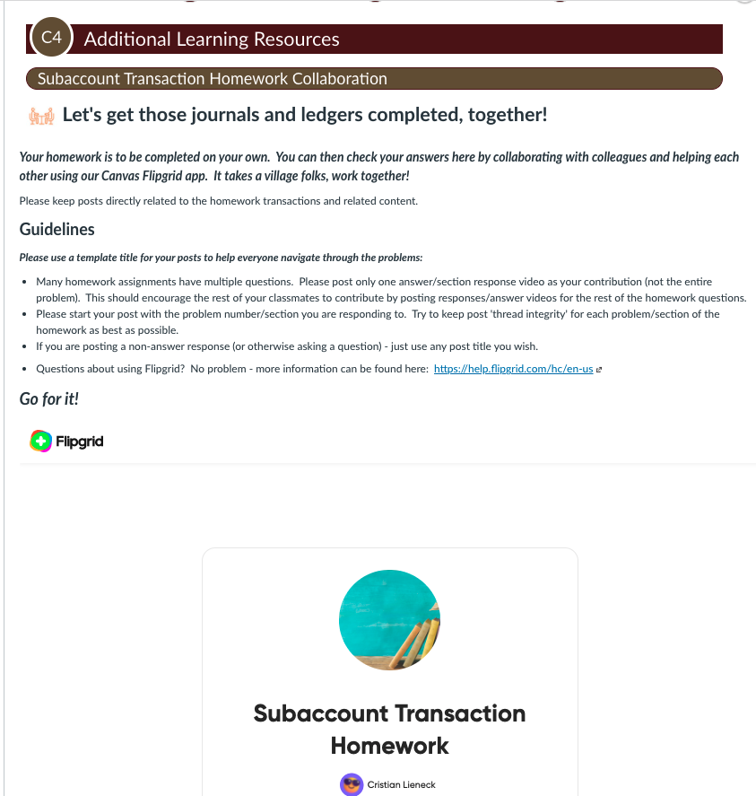
Assignment sample – Student modeling and discussion
Metacognitive modeling videos –
Students solve problems on their own but record themselves doing so while they think aloud. Then they post their videos here for peer feedback using Flipgrid.

Slide 9
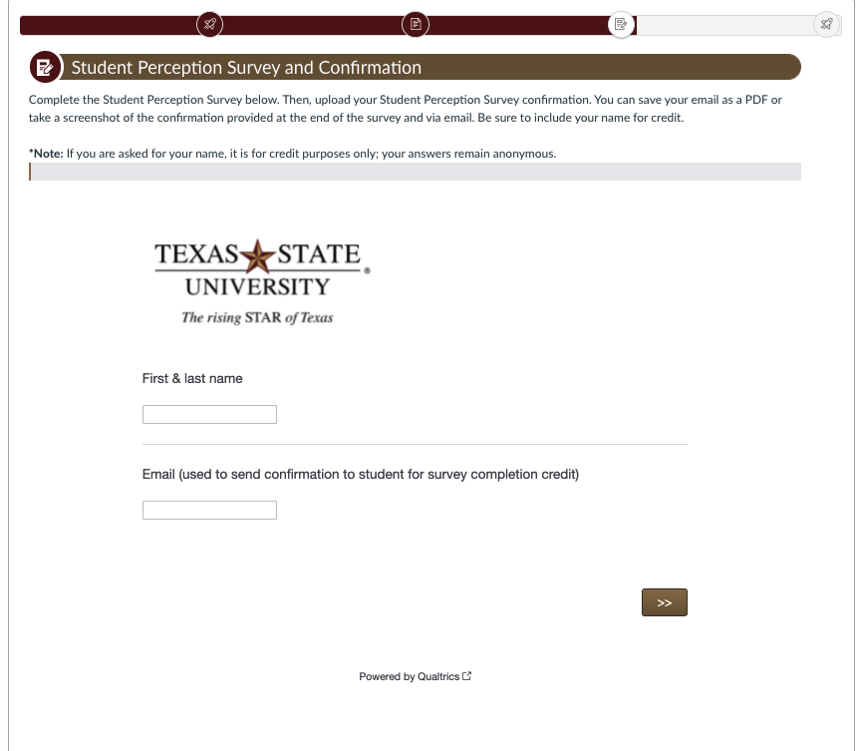
Student Perception Survey
End of Course Survey
The Student Perception Survey (SPS) is given at the end of the course. In this course, students can earn 10 points for completion. Names and emails are only needed for personalized confirmation of completion messages. This identifying information remains separate from the student responses.

