Slide 1
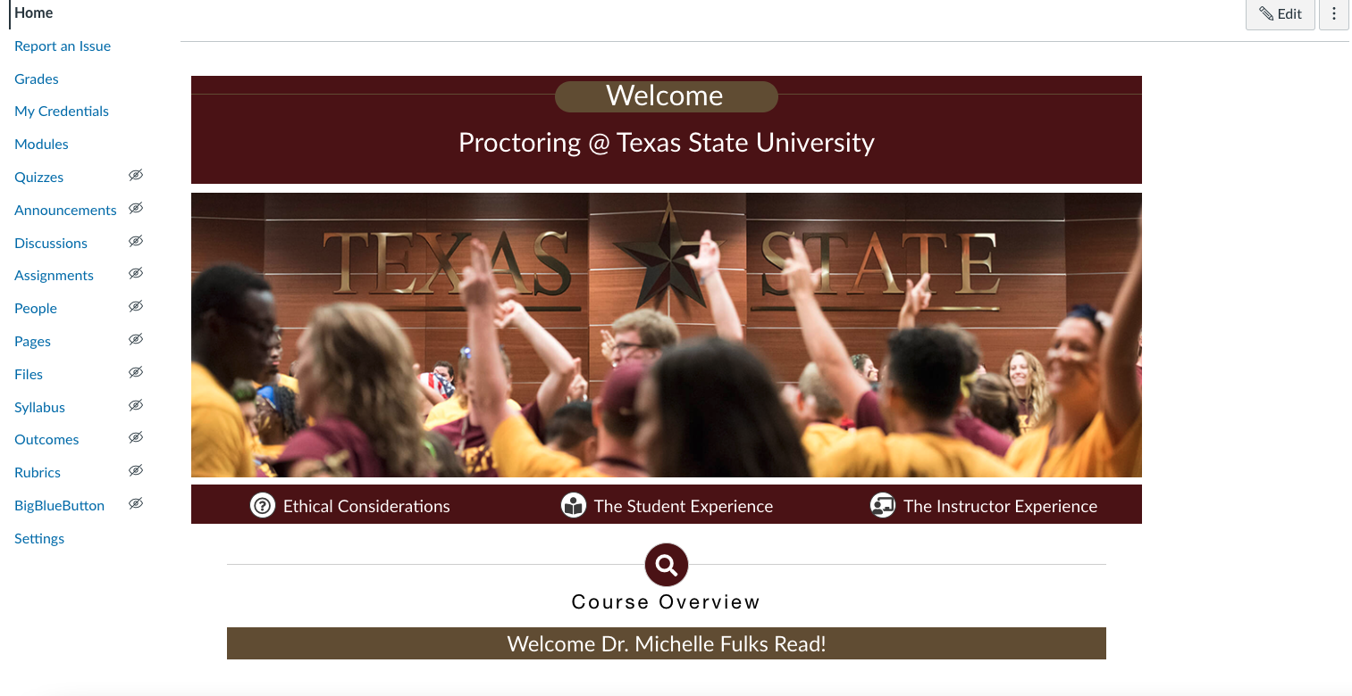
Home
Client: AVP ODEL
Status: Awaiting Content
Audience: Instructors wishing to use one of two proctoring services online at TxState University.
Description: Mandatory course for instructors who want to use proctoring services through ODEL. Instructors will receive badges for completion – either Proctorio or Examity competency.
This homepage uses some custom coding to display the user’s full name, which is not readily available in the Canvas LMS, but I feel adds a special touch of personalization making students feel they belong.

Slide 2
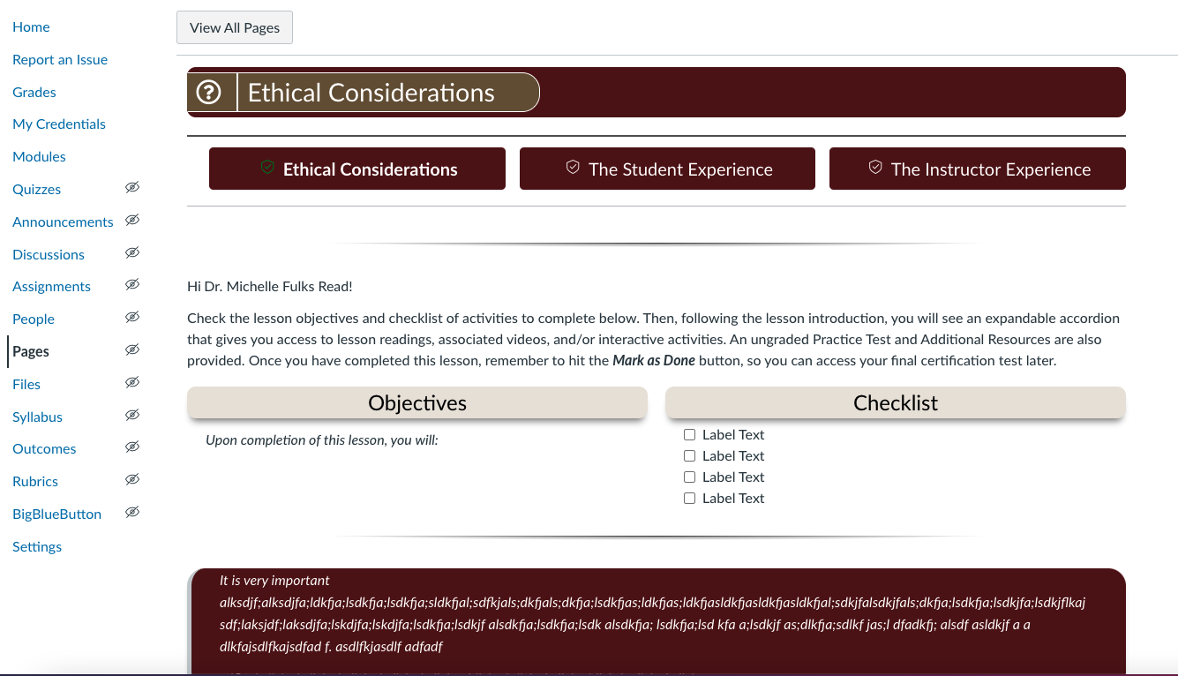
Sample Lesson page – top only
This sample lesson page, Ethical Considerations, is one of three modules instructors must take. Each module ends in a short quiz that users must make a 100 on to move forward to the next module.
Instructors can access completed modules by clicking on one of the three buttons displayed on every page (including the Homepage) or by clicking the Modules tab in the navigation panel.

Slide 3
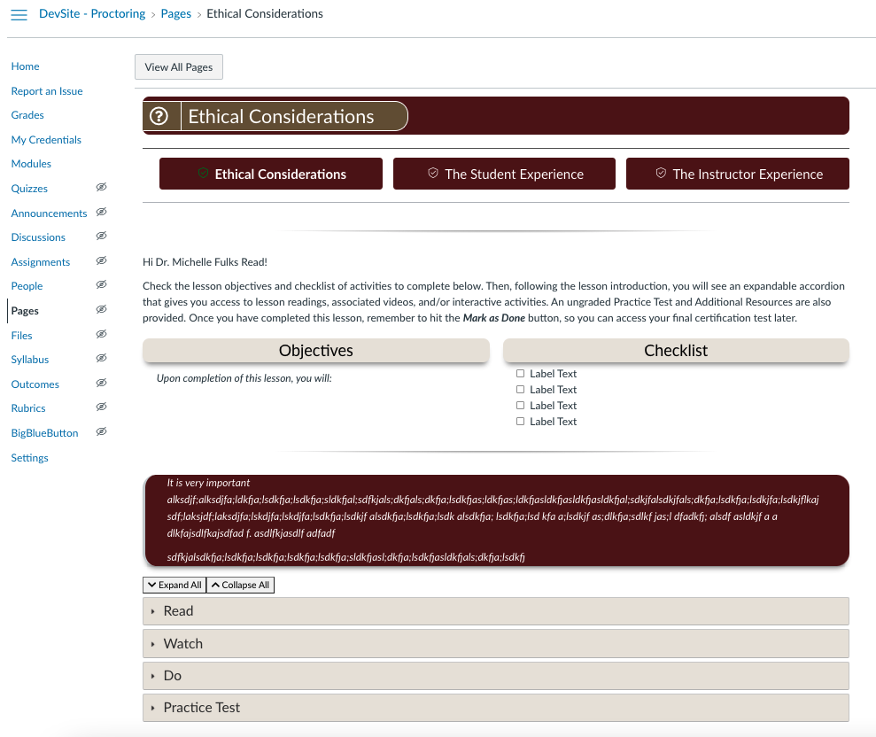
Example Lesson Page
Each of the three module pages instructors will view contains the title of the module, the navigational button options to move between modules, an overview with objectives and an interactive checklist that allows instructors to be sure they’ve completed all requirements. Most salient take-aways or quotes are highlighted in the maroon block text. Finally, expanders include sections for associated learning material: Read, Watch, Do, Practice Test. The Next button at the bottom of the page also allows them to go directly to the quiz.

Slide 4
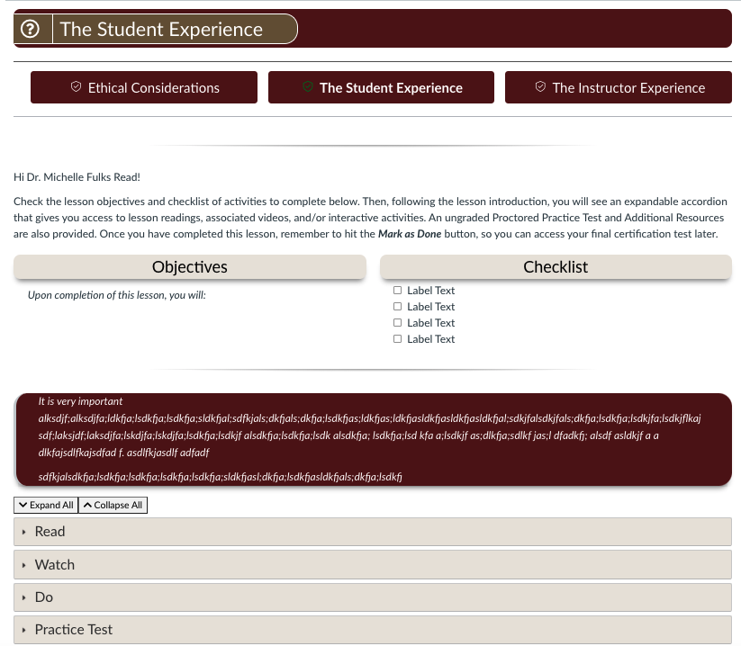
Student Experience Page
For each of the three modules, participants will be asked to complete a topical quiz. For the Student Experience, we are asking the participants to take the quiz using the proctoring service they are studying, so they may experience what their own students will experience in the process.

Slide 5
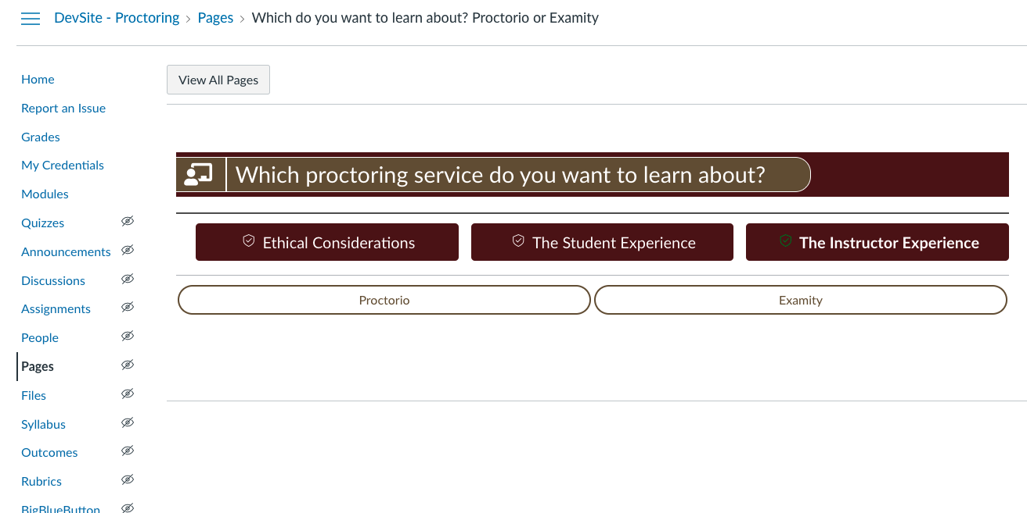
User decides path
The final module, The Instructor Experience, forces users to choose which proctoring service they want to become certified to use – Proctorio or Examity. The Next button has been hidden on this page to force users to make a choice.

Slide 6
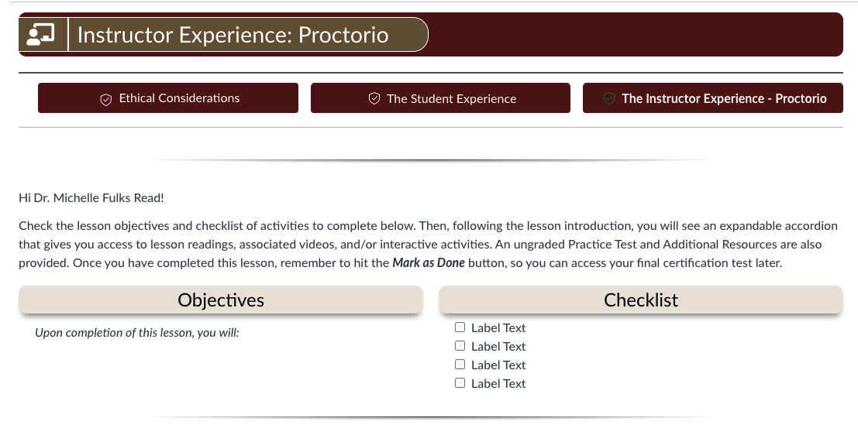
Sample lesson page – top
Once users have made a decision, they must go back to Home to click the The Instructor Experience button to change their choice. This allowance is desirable for those who may want to be certified in both. Meanwhile the Ethical Consideration and The Student Experience buttons always return to their completed work.

Slide 7
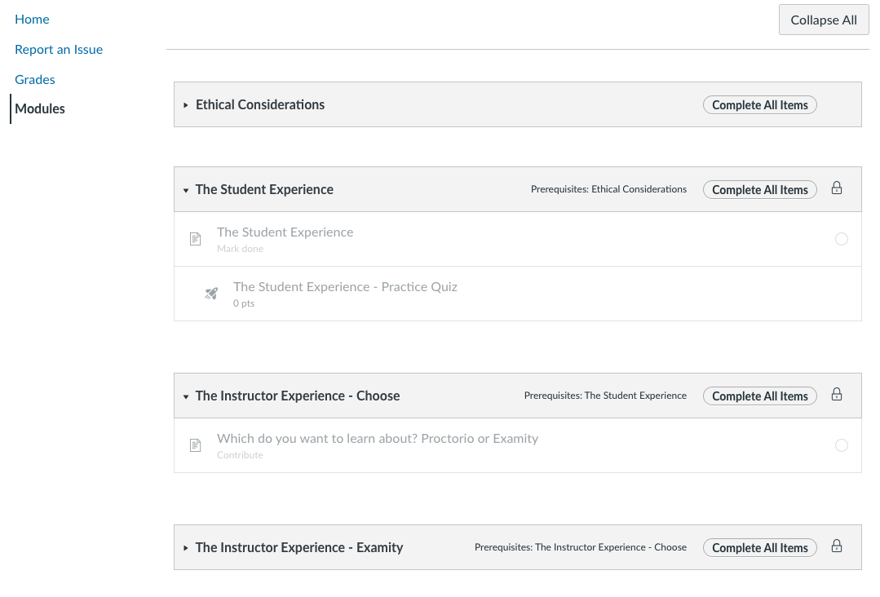
Modules
Student View –
Faculty participants will only see the four main buttons (Home, Report an Issue, Grades, and Modules) when logged into the course, which opens at the Home page. This screenshot shows the Modules page.
The course navigation forces sequence. If a student were to click on the Student experience, for example, on the home page, they would be denied entry to the page due to parameters set up here.

Slide 8
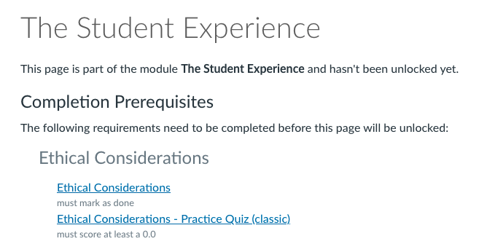
Error Message received when learners click too soon
Student View –
The course navigation forces sequence, as seen on the Modules screenshot before. This is the message participants receive if they try to access a page they are not allowed to yet.

Slide 9
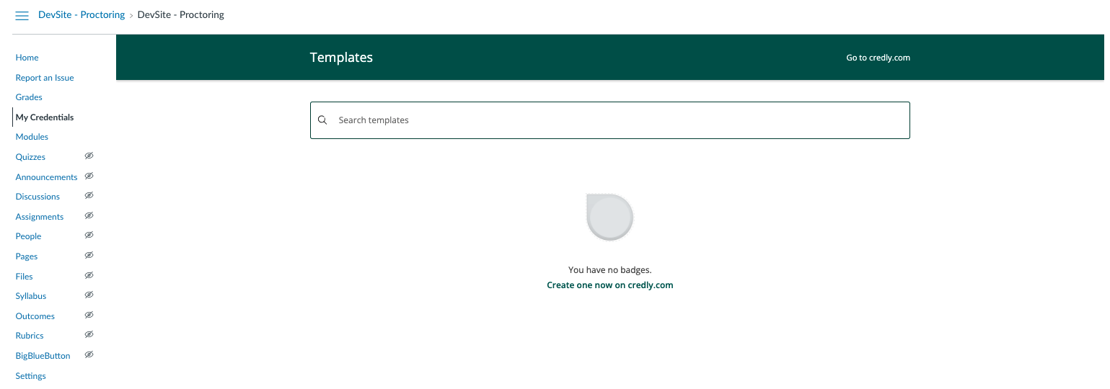
Badges
The My Credentials tab, currently only viewable by designers, will allow participant to easily access and share their proctoring certification badges. Our marketing department is currently developing a representative icon for our university and department. Requirements for receiving the badge include passing each of the 3 quizzes (80%>) given for each module.

