Slide 1
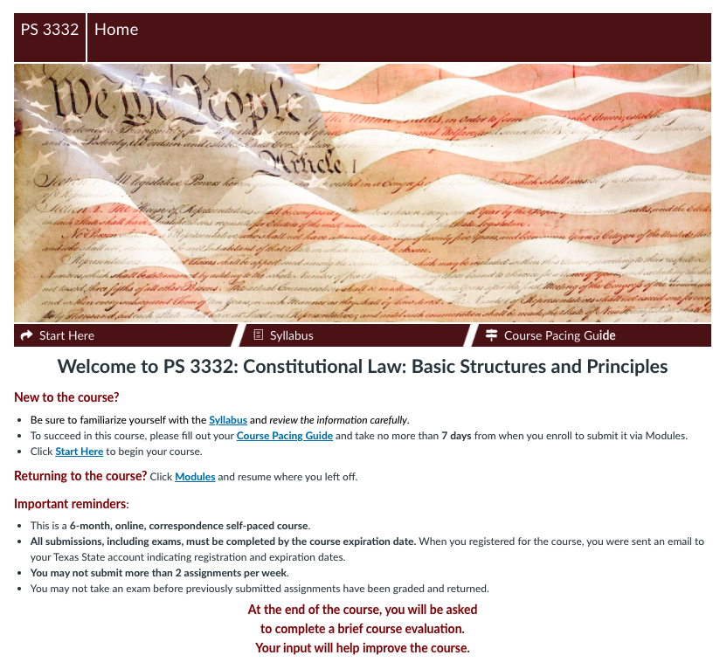
Home page
Client: Political Science 3332 – Constitutional Law: Basic Structure and Principles
Status: Complete, waiting revisions
Audience: Students needing this course to graduate from their program, ad hoc
Description: This self-paced correspondence course allows for six months for completion.
Homepage –
This page contains a brief course welcome and completion reminders. Shortcuts to the Start Here page and the Syllabus are provided along with a link to a Course Pacing Guide. One of the first assignments is to add dates to t he Course Pacing Guide and submit your plan to the assignments tab.

Slide 2
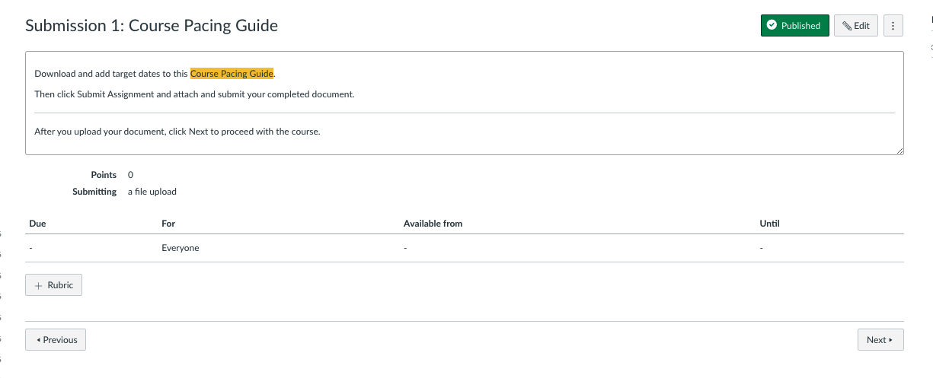
Course Pacing Guide
Course Pacing Guide –
Once students have completed this assignment, they can then move on to the rest of the course.

Slide 3
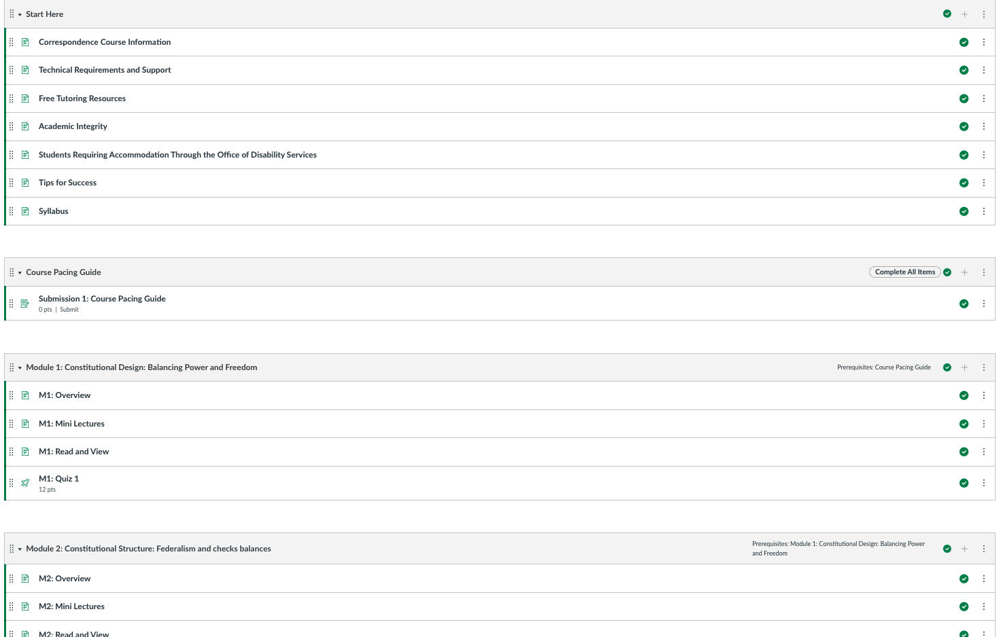
Modules page
Modules page
Students must complete the module lessons in order. Next modules will not open until requirements for previous modules have been met.

Slide 4
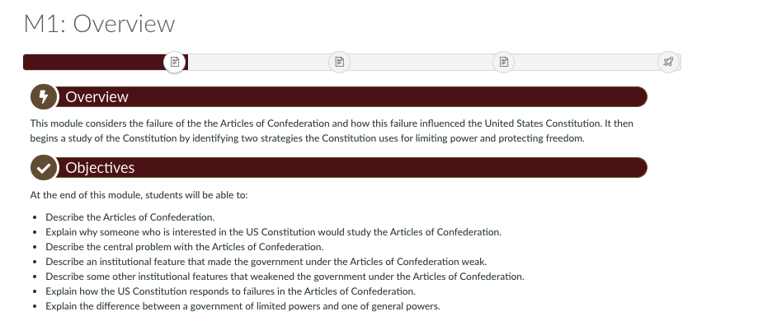
Typical Lesson Page 1
Lesson page
Each lesson is divided up with multiple pages: Overview & Objectives, Mini Lectures, Read and View, and Quiz.
A navigation bar is provided at the top of each page for easy maneuvering between module components. Alternatively, student can simply use the Next button to proceed through the module content into the module quiz and then into the following modules.

Slide 5
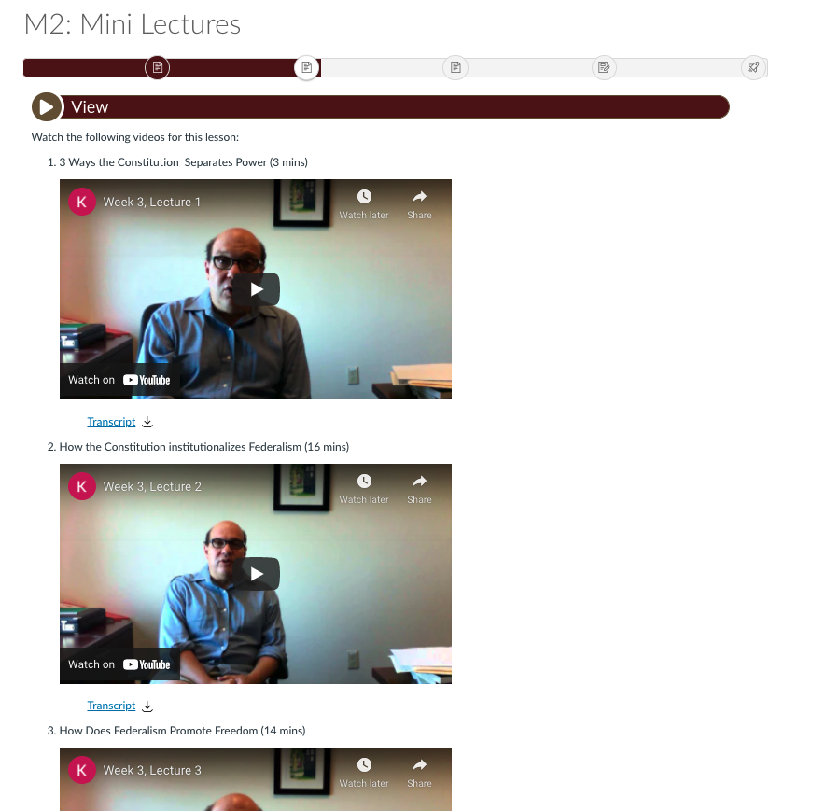
Typical Lesson page 2
Lesson page
Each mini lecture is chunked to appropriate lengths and contains a separate transcript file for accessibility.

Slide 6
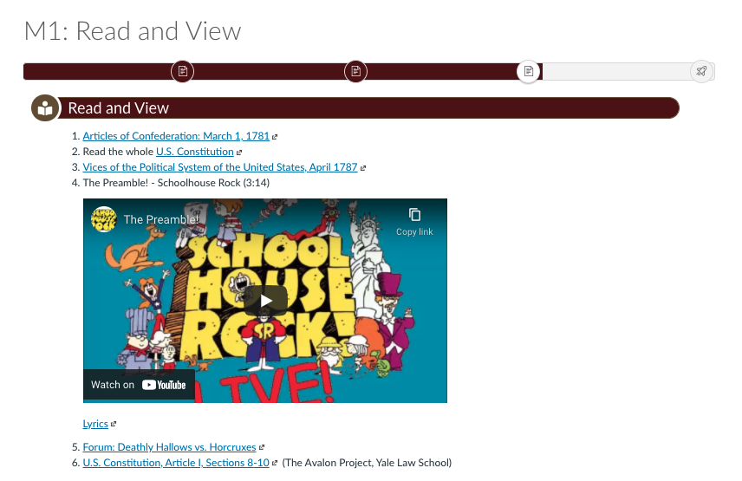
Typical Lesson page, 3
Lesson page
Each Read and View contains links or attachments to readings (if allowable by Fair Use) and embedded 3rd party videos.

Slide 7
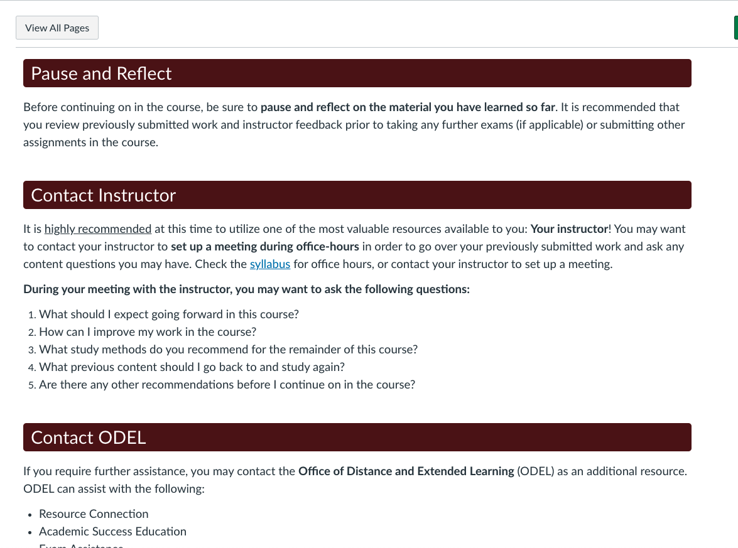
Mid term Checkpoint
Mid-term
This page asks students to stop and check themselves on their progress through the course. The next page asks the student to pause and reflect on what they have learned so far and suggests contacting their instructor.

Slide 8
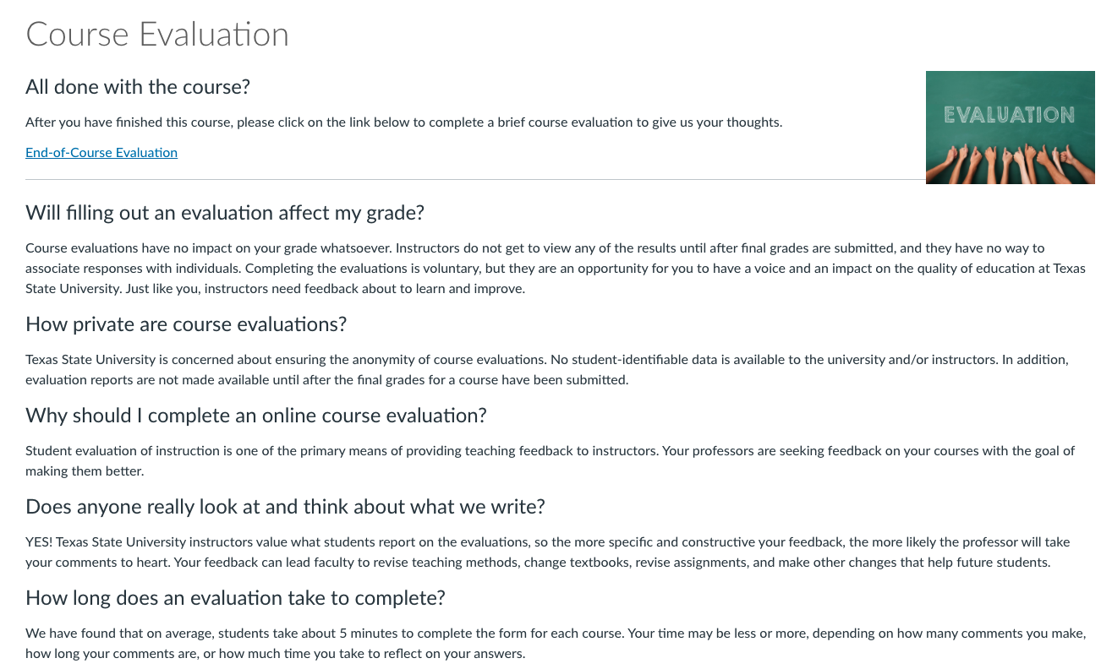
Student Perception Survey
End-of-Course Eval
A student perception survey is provided to the students to get their feedback on the course design.
This course received high marks and thankful comments for making the course so easy to navigate and complete.
Only suggestion – add opportunities to see other students in action in the course via polls.

