Slide 1
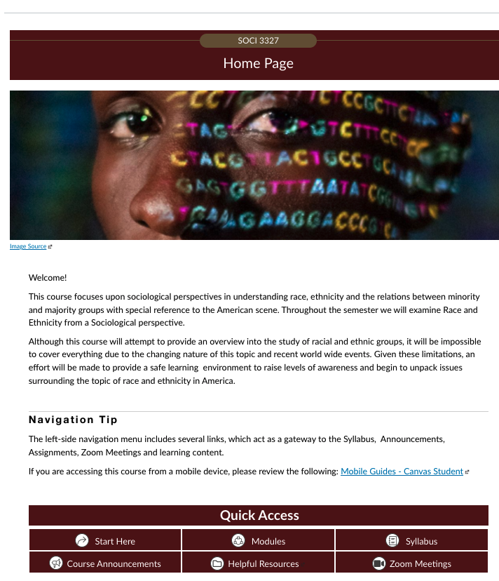
Home page
Client: Sociology 3327 Race and Ethnicity; Lisa Ann Weber, SME
Status: Complete, waiting for initial run
Audience: Students needing this course to graduate from their program
Description: Online with Zoom meetings
Homepage –
This homepage utilizes quick access and icons. It provided basic information about the courses welcoming students to the page and navigation tips.

Slide 2
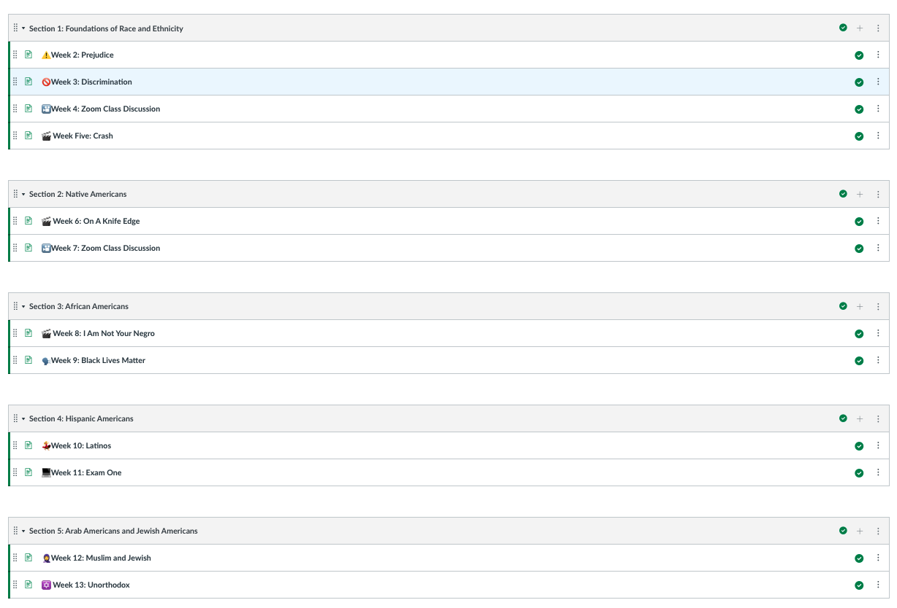
Modules
Modules
This course contains 5 content modules + a Start Here module and a final exam module. The course needed to be designed for both short and long semesters.

Slide 3
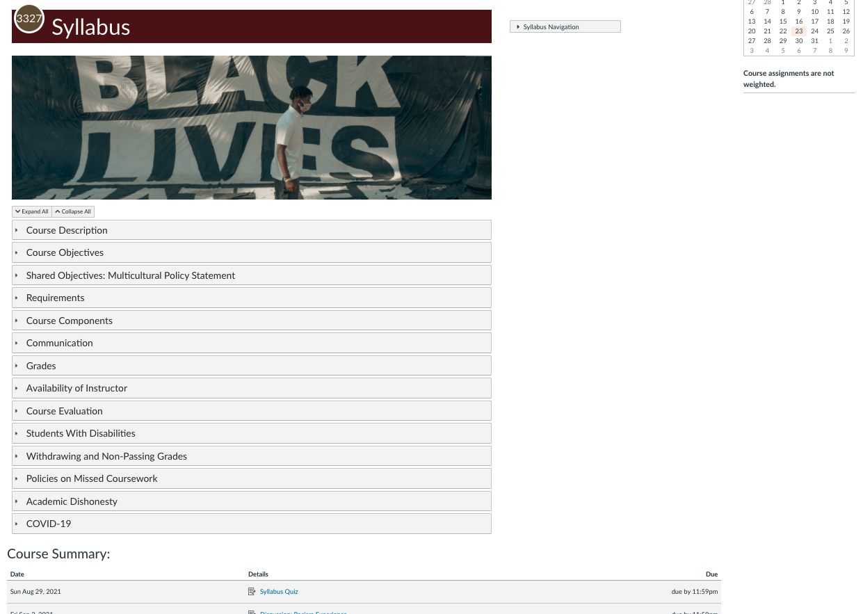
Syllabus
Syllabus –
The syllabus content is added directly to the Syllabus page (as opposed to simply a downloadable link). Each section of the syllabus appears in an expandable section. A course summary appears at the bottom outlining all assignments due.

Slide 4
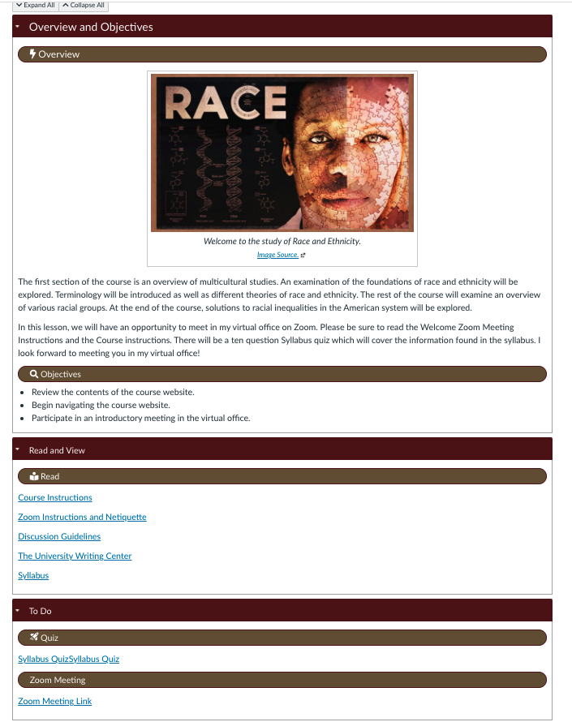
Start Here Page
Start Here module -- first page
The Start Here module contains 3 pages: The first gives information about the course, what to read in advance, a syllabus quiz, information about Netiquette, discussion guidelines, and a link to the university writing center, along with a link to the first Zoom meeting. The second page is an about page and contact information for the instructor, while the last page is the same for the TA.

Slide 5
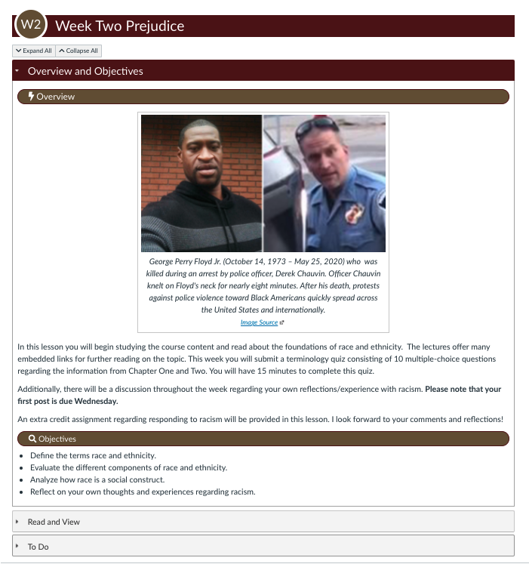
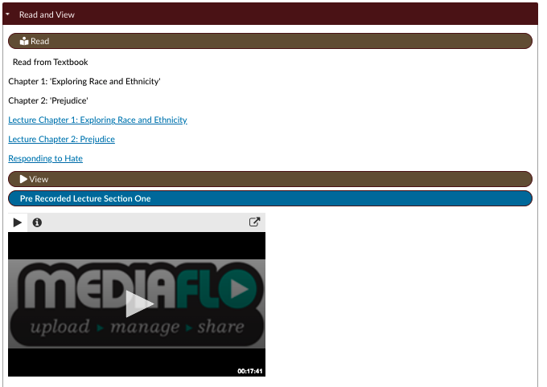
Typical Lesson Page
Typical module lesson page –
This course utilizes a single lesson page layout with maroon section headers and the use of expanders for the Read and View and To Do sections, which contain links and embedded videos when needed.

Slide 6
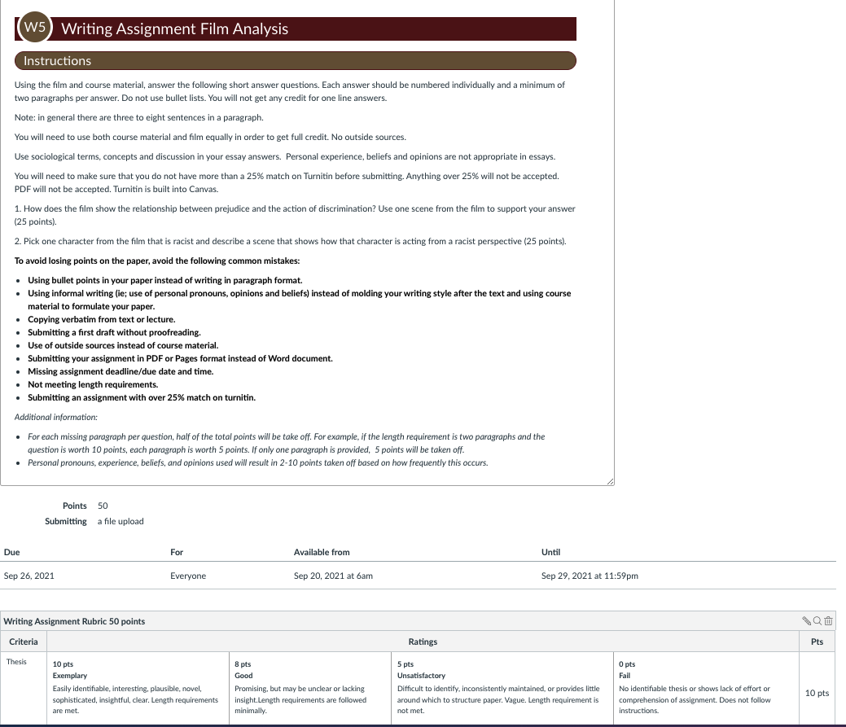
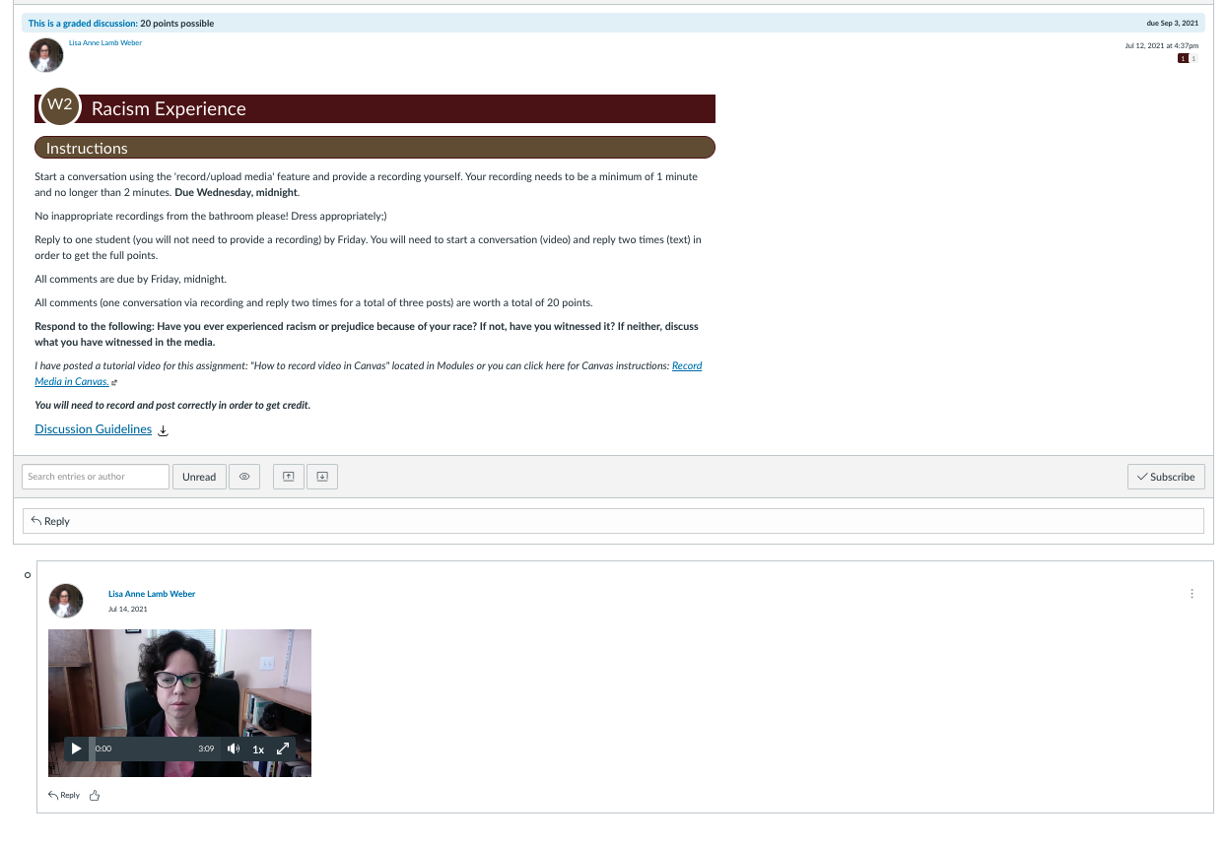
Typical Assignment with Rubric sample
Typical Assignment –
This course contains a lot of film analysis assignments and profound discussions.

Slide 7
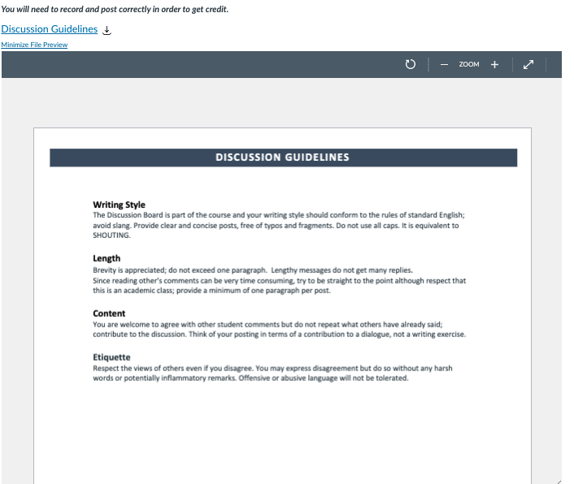
Typical Discussion Sample with Guidelines & Instructor Model
Typical discussion –
Discussion Guidelines in preview mode embedded on the discussion page.

Slide 8
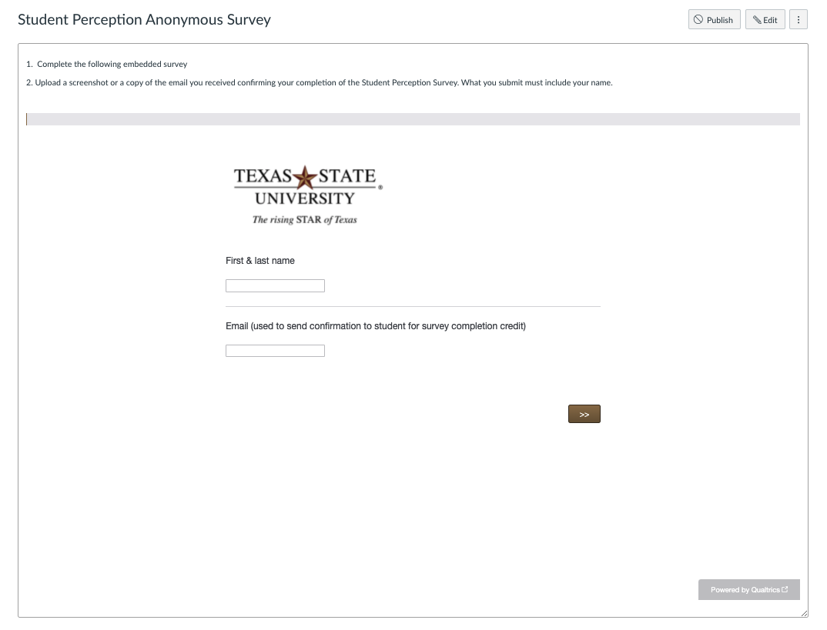
End-of-Course Survey (Student Perception Survey)
Student Perception Survey (SPS) –
Students can earn 15 extra points for completing this survey that guides future course design revisions. Names and email are collected only for the purposes of gathering a personalized confirmation of completion email to submit for credit. Else, responses are kept separate from names/emails.

