Slide 1
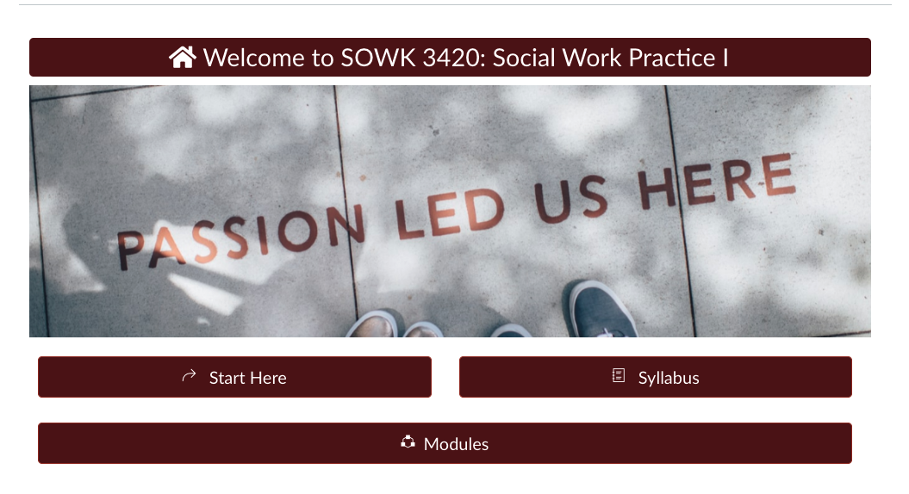
Home
Client: SOWK 3420 – Social Work Practice 1, Keri Anne Moon, SME)
Status: Complete, waiting for revisions
Audience: Students in their first practicum needing this course to graduate from their program
Description: Fully online course, with practicum hours, for the Bachelor’s program.
Homepage –
This very simplistic home page contains shortcuts only to Start Here, the Syllabus, and the course modules. These can also be accessed via the left navigation panel.

Slide 2
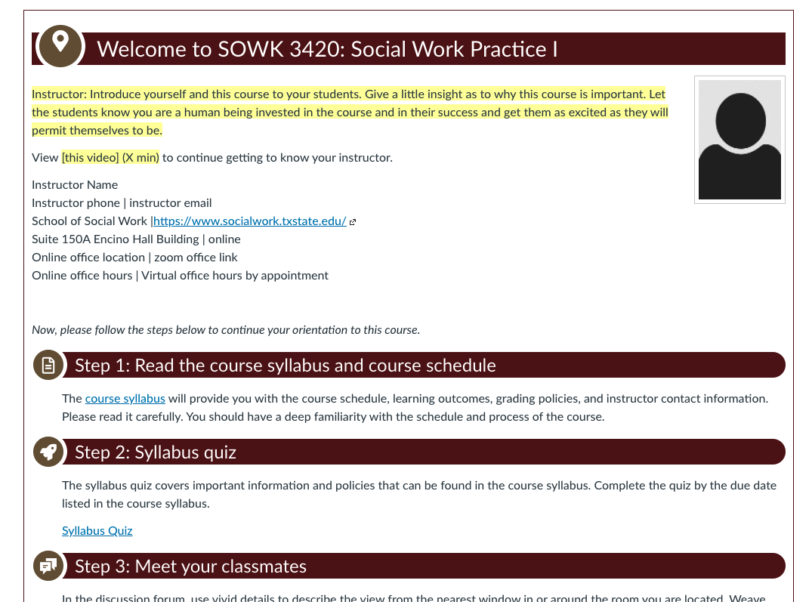
Start Here
Student Start Here –
This page is set up for other instructors assigned to teach the course to add their own information. See highlighted text.

Slide 3
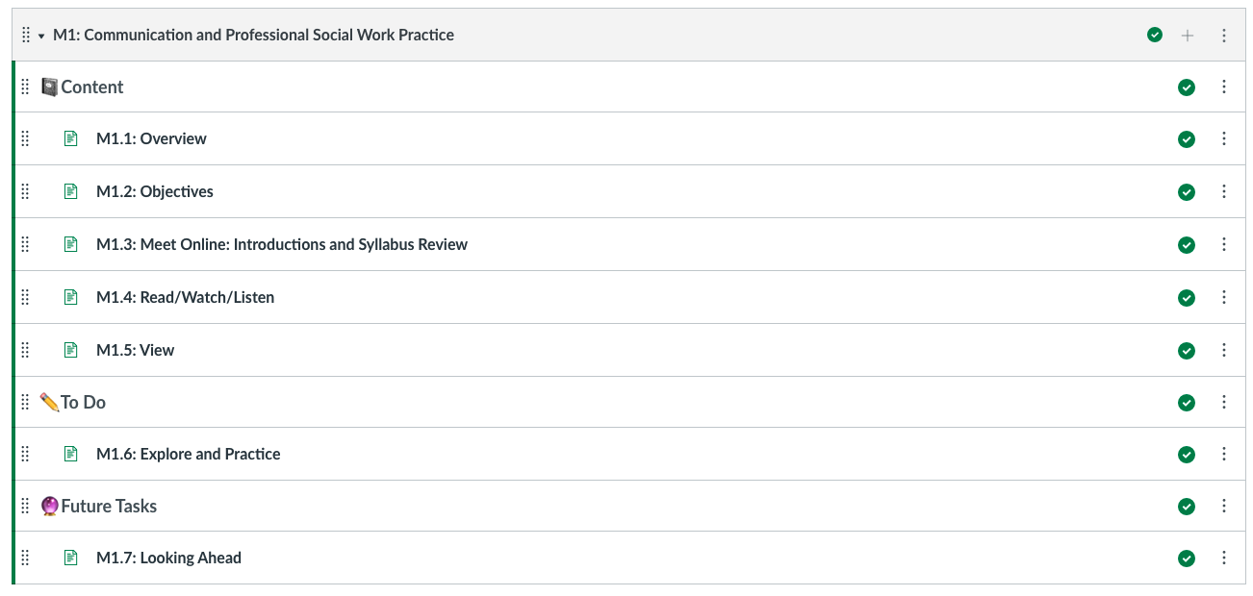
Modules
Modules page –
Each module is set up with Content pages (separate overview, objectives, zoom meetings, read/watch/listen, and additional view pages) followed by To Do activities and a Future Tasks section.

Slide 4
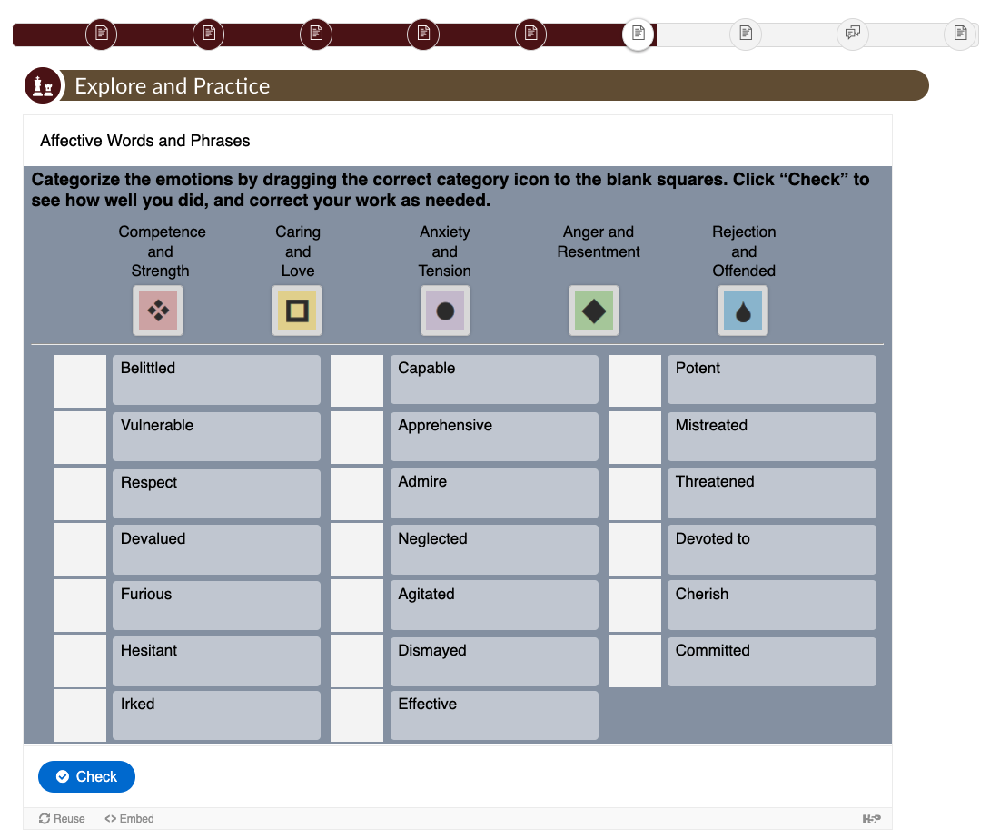
Explore and Practice 1 – H5P
Explore and Practice activity –
Drag and Drop built in H5P.

Slide 5
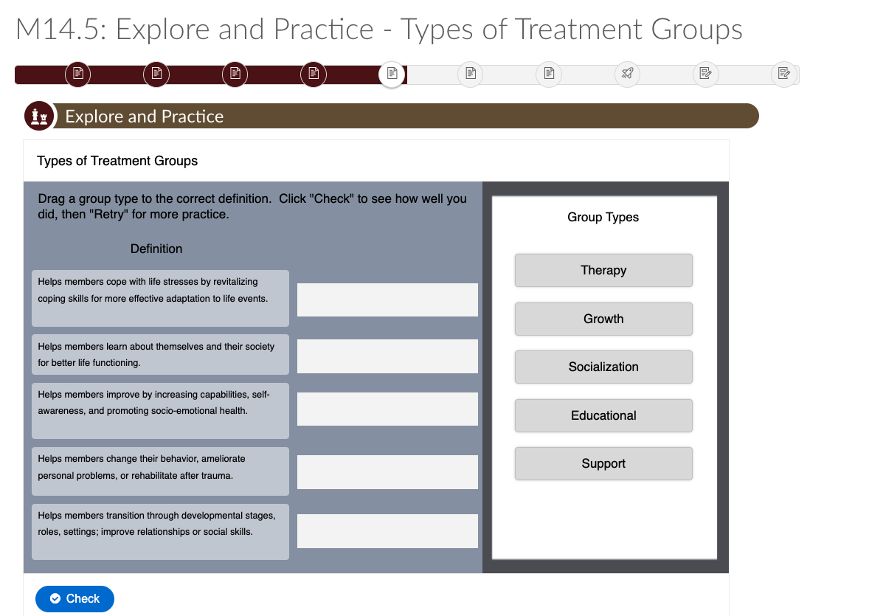
Explore and Practice 2 – H5P
Explore and Practice activity –
Drag and Drop built in H5P.

Slide 6
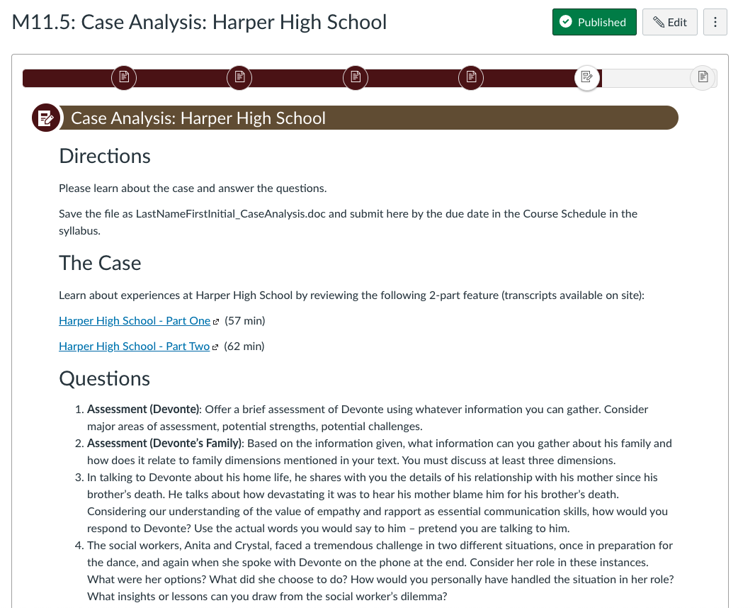
Typical Assignment, Case Analysis
Major course assignments –
The course contained several case analysis opportunities and group projects/discussions.

Slide 7
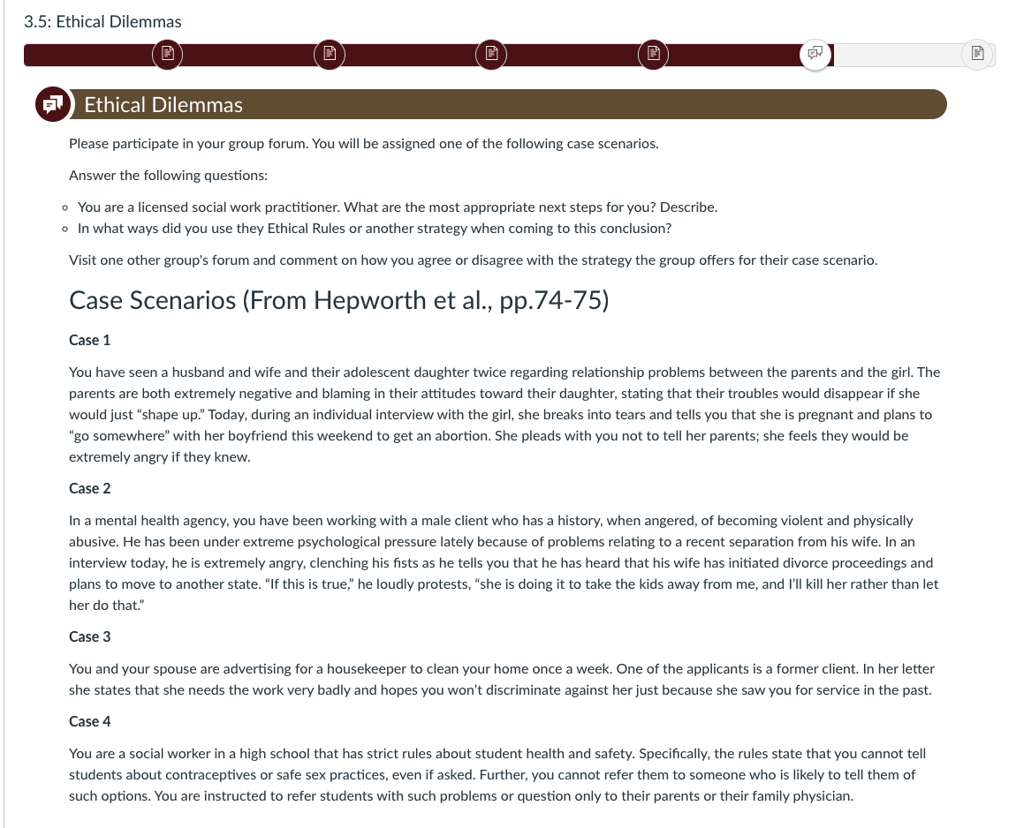
Typical Discussion – Ethical Delimmas
Major course assignments –
The course contained several case analysis opportunities and group projects/discussions.

Slide 8
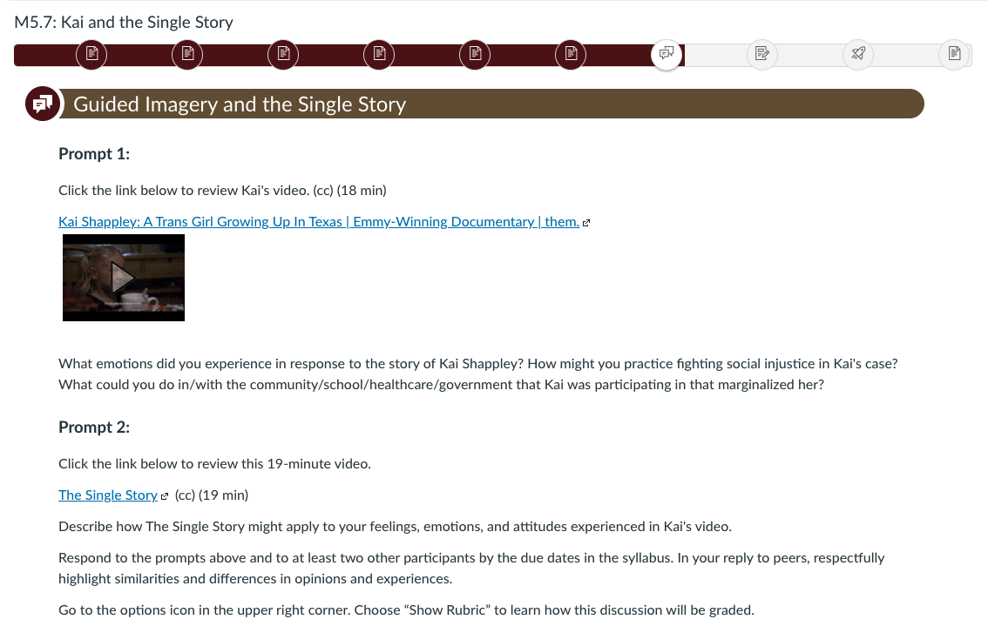
Typical Discussion – Guided Imagery activity
Major course assignments –
A guided imagery activity.

Slide 9
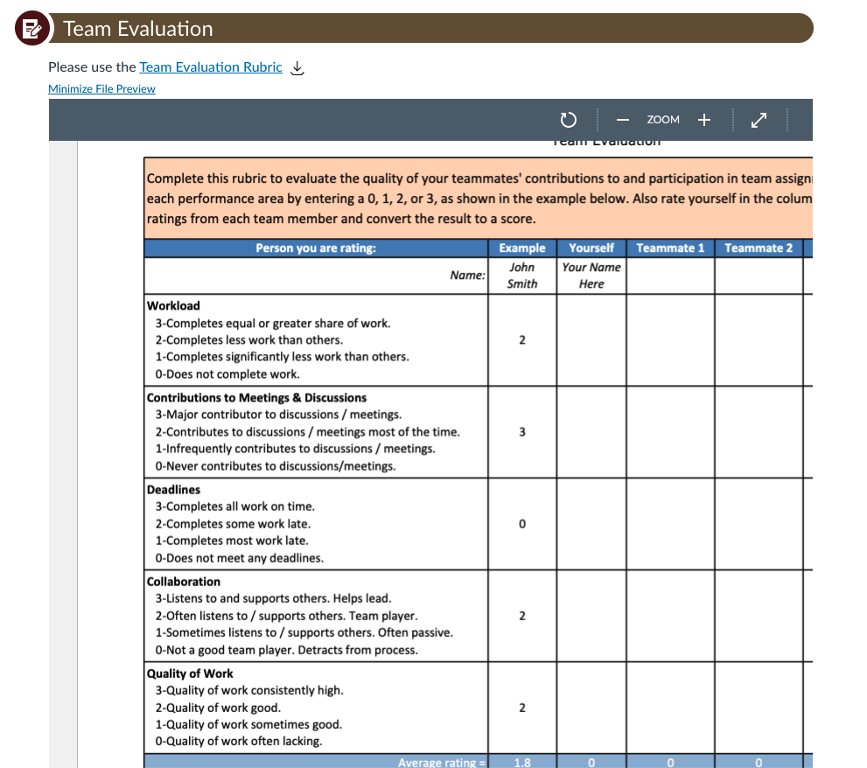
Mid term – Team Self-Peer Evaluations
Major course assignments –
Team Self/Peer Evaluation at mid-term.

