Slide 1
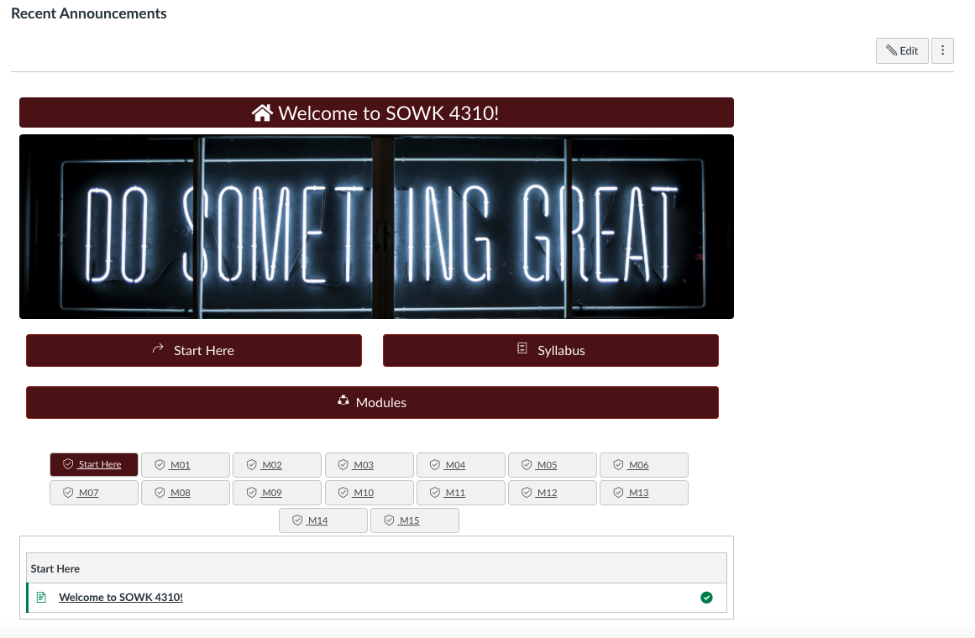
Home page
Client: SOWK4310 – Rose Pulliam
Status: Complete, waiting revisions
Audience: Students in the program as a required course.
Description: This course is entitled, Diversity and Social Justice, and looks at these issues through the social worker’s lens.
This homepage is purposefully simple containing each course module on the front page so students can easily see each completion status. Only shortcuts to the course Syllabus and Start Here are provided.

Slide 2
Instructor Start Here module
Like most other courses, I design, I include an. Instructor Start Here page, which remains unpublished so students cannot see it. In this module, instructors first see a list of instructions for preparing the course and are then provided with a wiki style page for making notes during teaching.

Slide 3
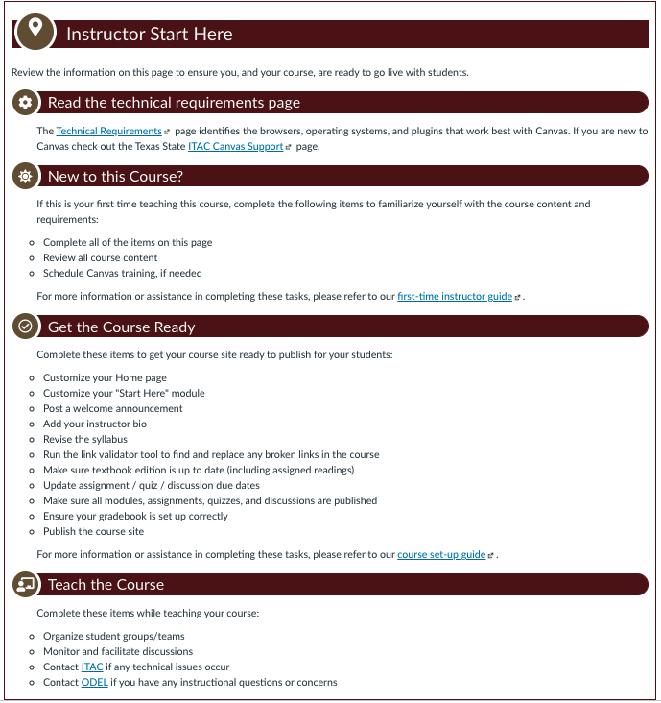
Instructor Start Here page
This simpler Instructor Start Here page contains a checklist of items to complete to prepare to teach the course.

Slide 4
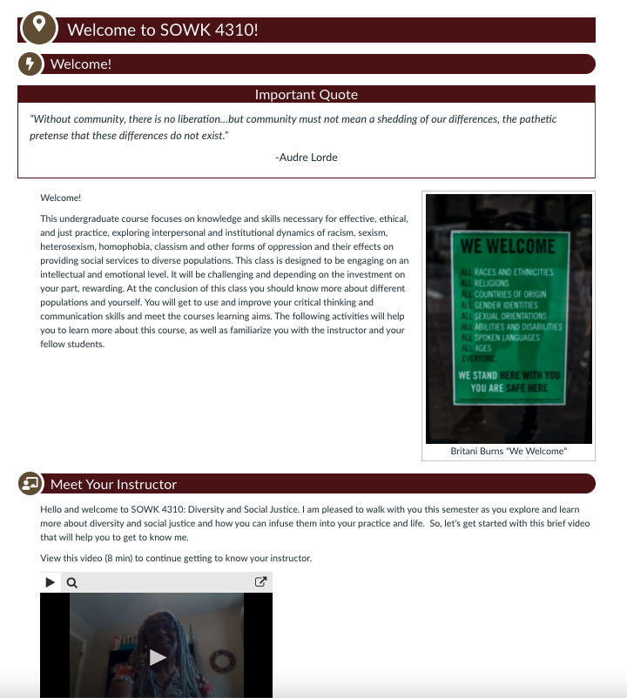
Student Start Here page
This student start here page gives students an introduction to the course, the instructor through a Meet the Instructor video, opportunities to explore library services, student services, Office of Disability Services, technical requirements, etc., along with built in tasks for taking a syllabus quiz and introducing themselves in a Introduce Yourself forum. The course also utilizes two additional general forums: Share and Tell and Problem Solver Forum.

Slide 5
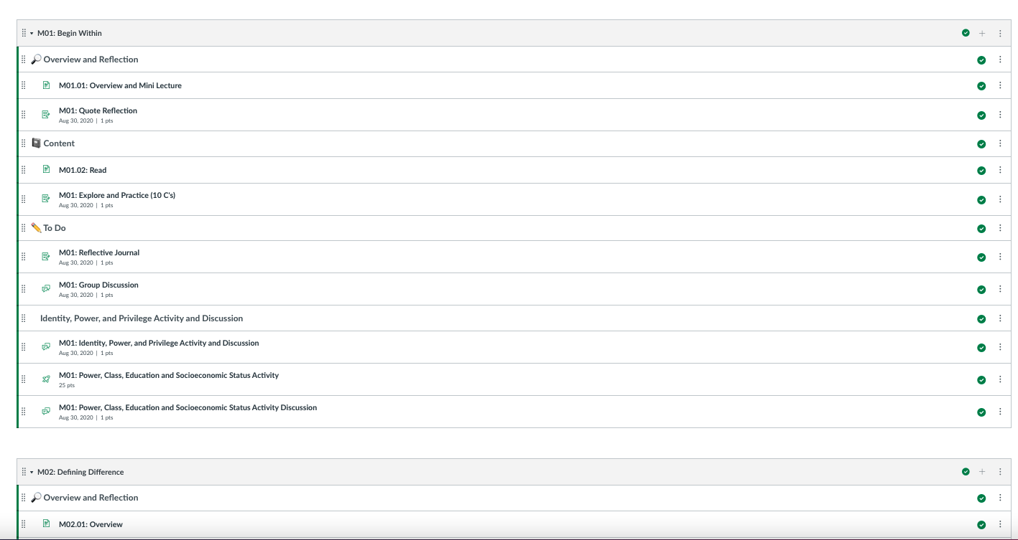
Modules
The course modules are straight-forward with no pre-requisites or requirements. All modules are open at the beginning of the course. Students can navigate by hitting Next on each page within the module or by returning to the Modules page.

Slide 6
Typical Lesson Page
Each lesson page within a module begins with a thoughtful quote to which each responds. The objectives are listed and a mini lecture follows. The videos are cc’d and accompanying PPTs are included.
Note the addition of module-based navigation bar at the top so students can easily move back and forth within the line items within the modules.

Slide 7
Weekly Quote Reflection Assignment
All lesson contain a meaningful quote at the beginning. After students have read or viewed the content, their first activity is to respond to the quote. The quote is always repeated at the assignment page. Guidelines are provided.

Slide 8
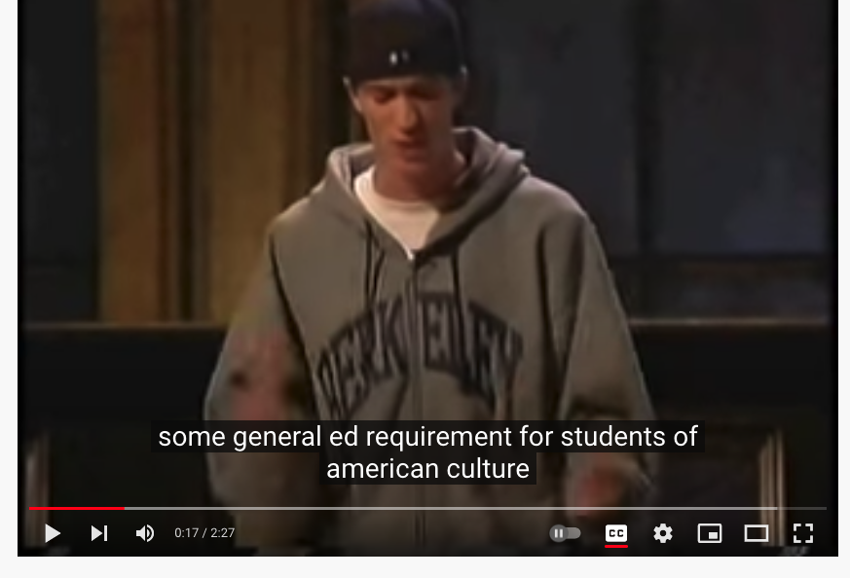
Links to Young Adult rants, poems, etc.
Additional Exploration and Practice resources are often provided. In this case, the SME wanted to include links to young adult performances on the topic of inequity (e.g., poetry slams, rants, comedians)

Slide 9
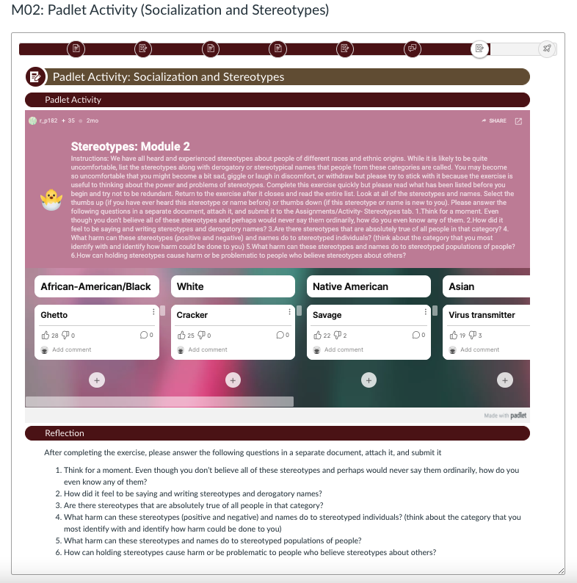
Padlet Activity & Discussion
Some activities were embedded within 3rd party sites (e.g., Flipgrid, Padlet, H5P). In this Padlet, students are asked to add stereotypical language to various groups and then reflect on the exercise.

Slide 10
Semester Project
This course contained an extensive semester long project with 15 divided milestones between the modules.

Slide 11
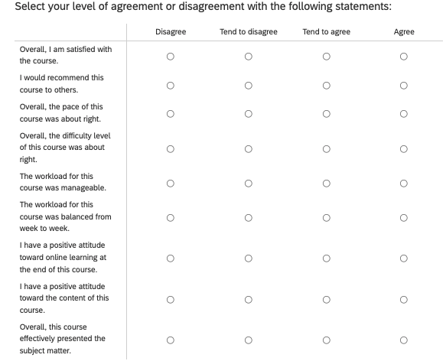
Student Perception Survey
Each course I create ends with a Student Perception Survey (SPS) built in Qualtrics. Each SPS is designed specifically to match the course, but begins with a specific template. It includes Likert scale and open-ended questions.
There were 52 responses to this survey for this course. While the majority of students liked the course, many were overwhelmed by the module quizzes, the multi-step project, and the number of assignments in general. Suggested revisions included simplifying the project, taking out quizzes and look for understanding the reflections also assigned, and providing a checklist within the syllabus.

