Slide 1
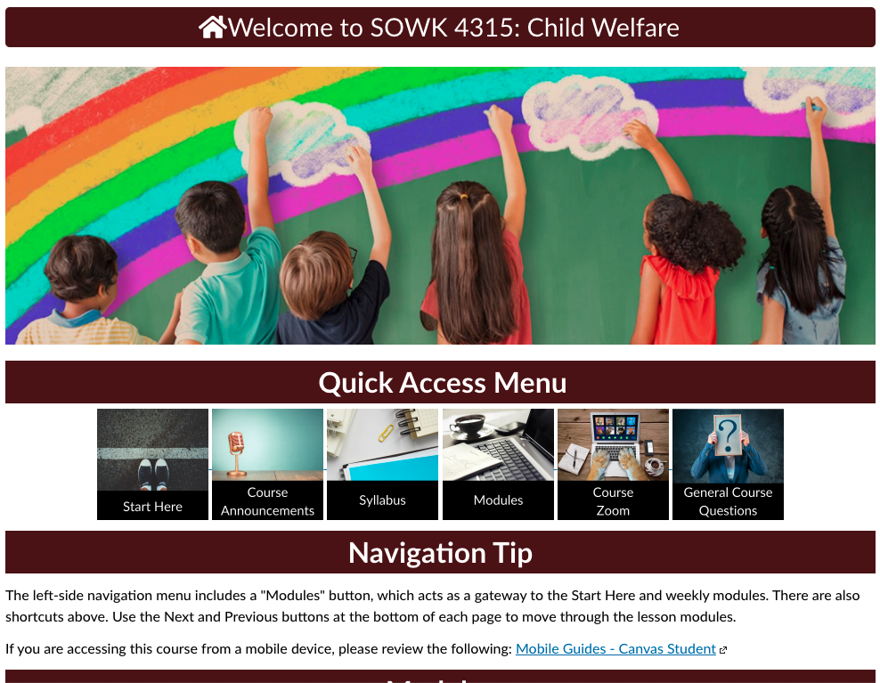
Home
Client: SOWK 4315 – Child Welfare, Richard Brooks (SME)
Status: Complete, waiting to run
Audience: Students needing this course to graduate from their program
Description: Fully online course for the Bachelor’s program.
Homepage –
This page contains a Quick Access menu to the Start Here page, the Course Announcements, the Syllabus, the Modules, Zoom, and General Course Questions forum. The image buttons were created using Canva. A navigation tip is also provided, along with a list of modules, which can also be accessed through the left side navigation panel.

Slide 2
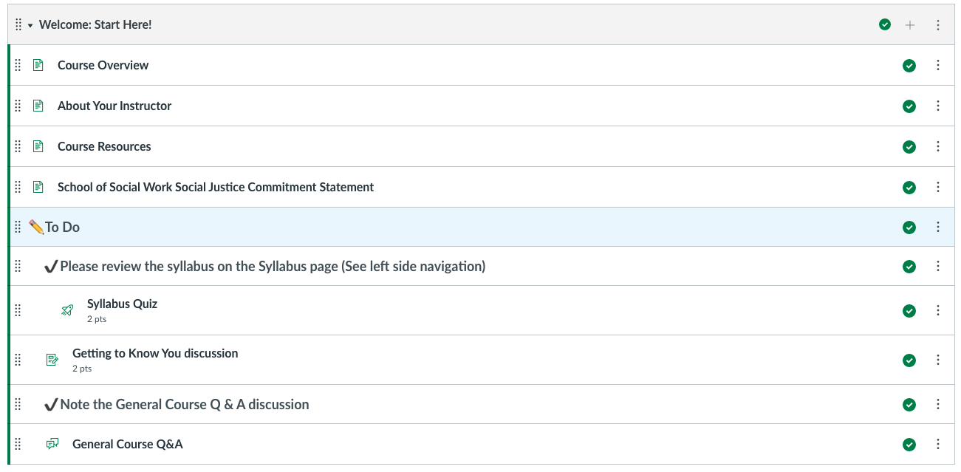
Student Start Here Module
Student Start Here -
Normally, a student Start Here page is one long page of “steps” to complete before starting the course. Here, we decided to break the information down into several pages within the module.

Slide 3
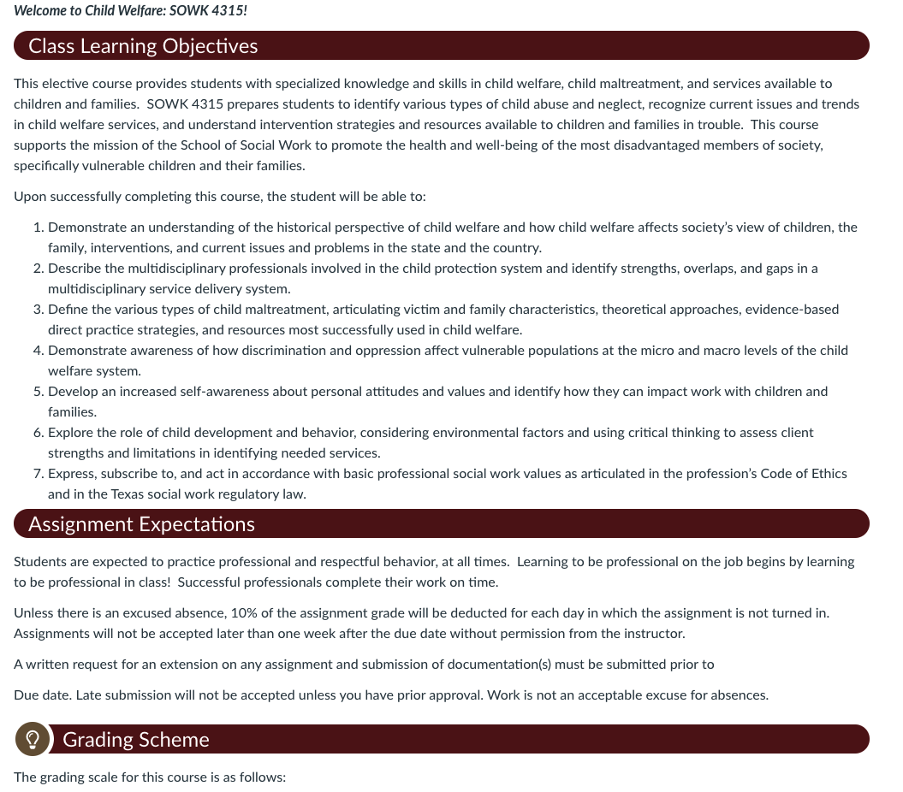
Student Start Here – First Page
Student Start Here -
The pages within the Start Here module are broken up into sections similar to what would be found in a syllabus.

Slide 4
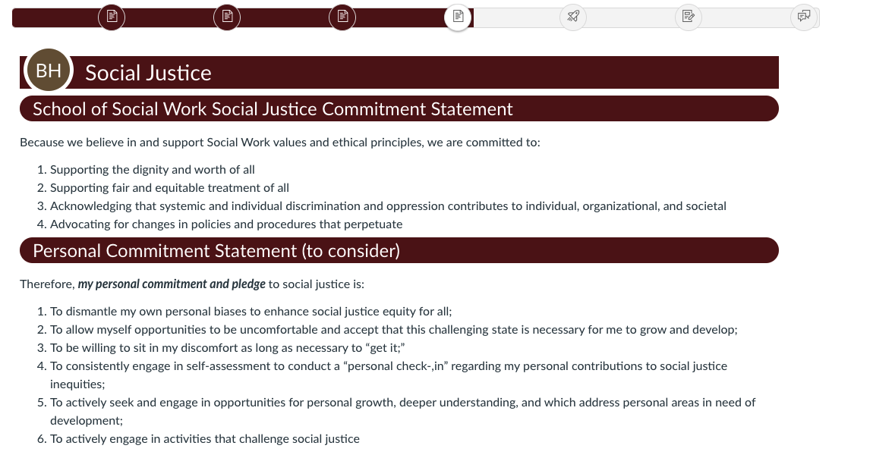
Social Justice Commitment Statement
Student Start Here -
The Start Here module contains a page reminding students of their departmental Social Justice Commitment Statement and their Personal Commitment Statement.
Also, in this module line up, students will find a link to the General Course Q & A forum, a syllabus quiz, and a Meet and Greet introductions forum.

Slide 5
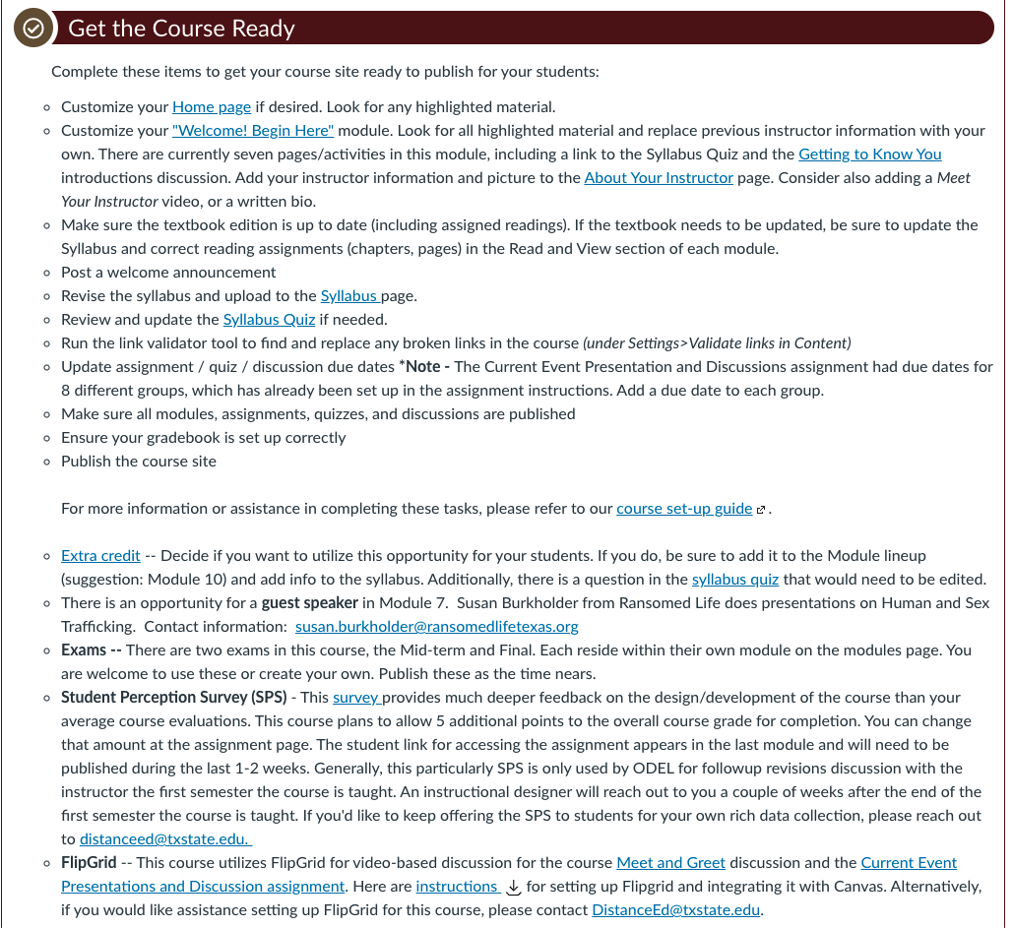
Instructor Start Here
Instructor Start Here (hidden from students)
This module contains a page providing instructions on setting up the course. It also provides a wiki style page for instructors to add notes while teaching the course.

Slide 6
Ongoing Assignment – Current Events group activity
Ongoing Assignments module –
This module explains a weekly assignment provided to student groups throughout the semester regarding related current events.

Slide 7
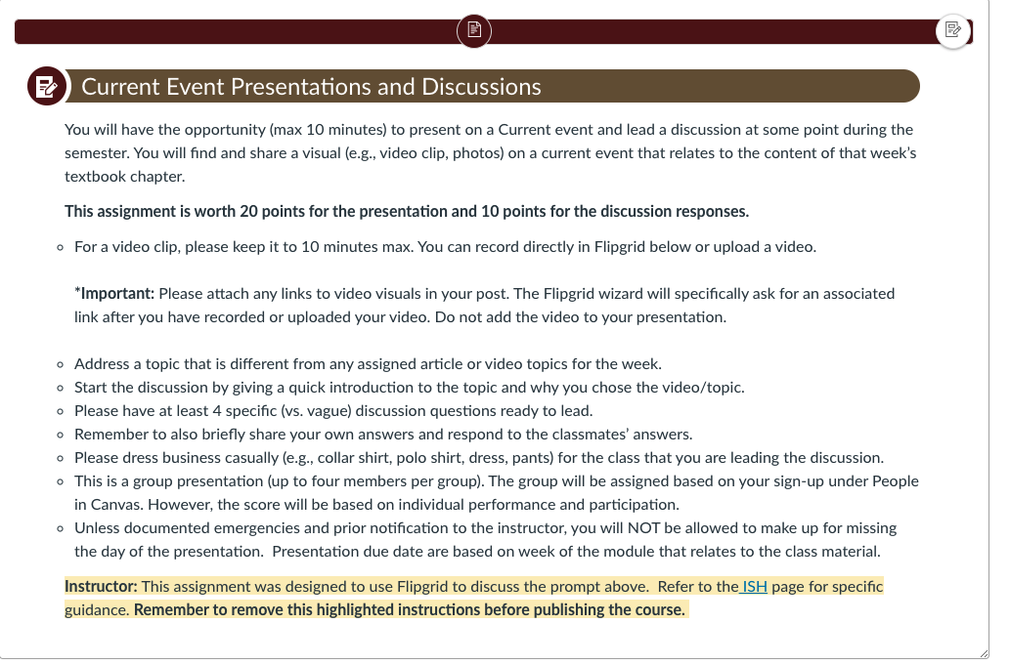
Current Event Presentation & Discussion instructions with space for embedded Flipgrid
Current Events Presentations & Discussions
This course utilizes Flipgrid for this assignment. However, the instructor (quite often not the SME) will need to set up Flipgrid themselves. They are redirected to the Instructor Start Here page. See highlighted text at the bottom of the page.

Slide 8
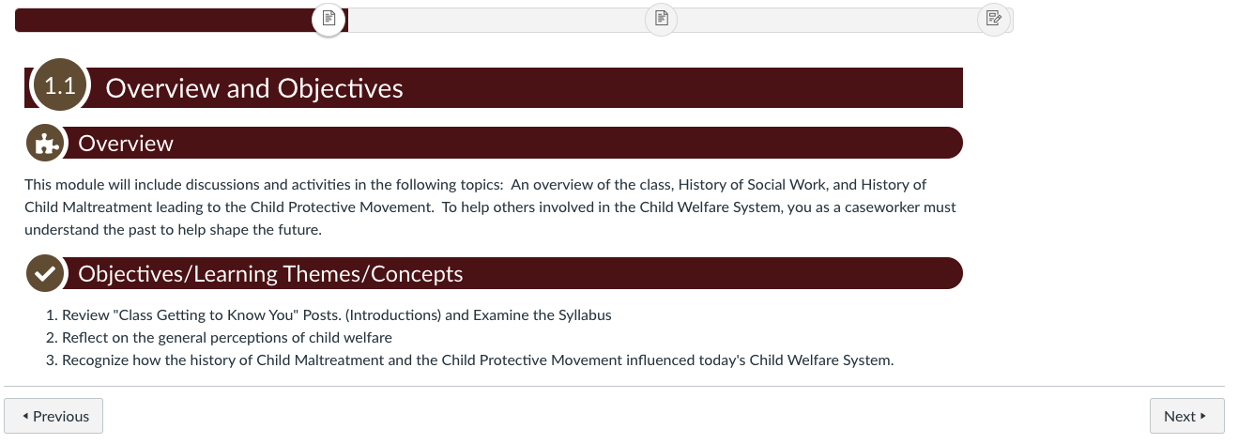
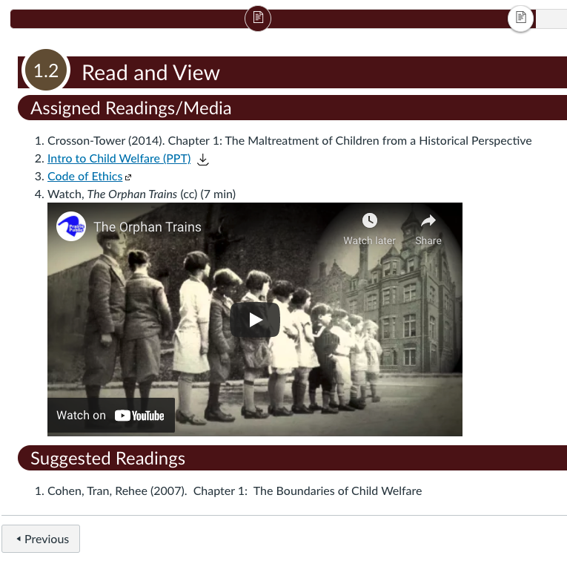
Typical Lesson Page layout
Lessons
Each module lesson is comprised of two pages and an assignment. The first page contains the Overview and Objectives. The second page contains the Read and View elements.

Slide 9
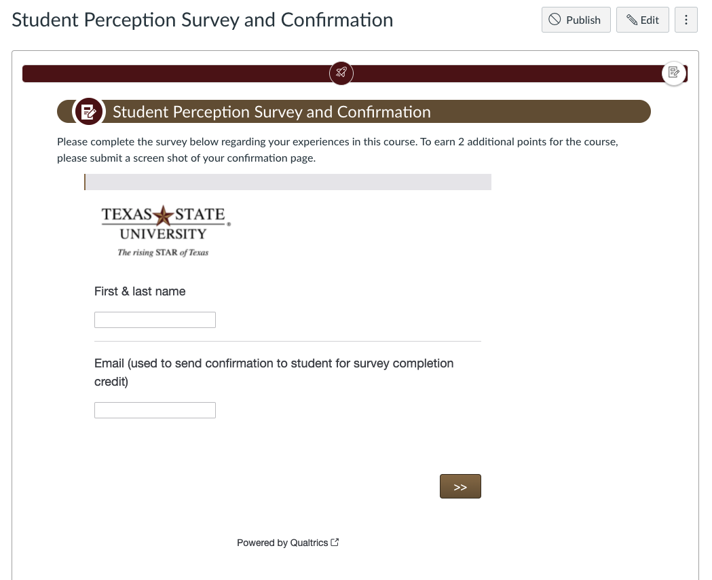
Student Perception Survey
End-of-course evaluation
Students will be given the opportunity to additional bonus points for completing the Student Perception Survey (SPS). The evaluation remains anonymous by separating their responses from their names in the final report. Name and email is only collected so students can submit a screenshot of PDF copy of their confirmation response for credit.

