Slide 1
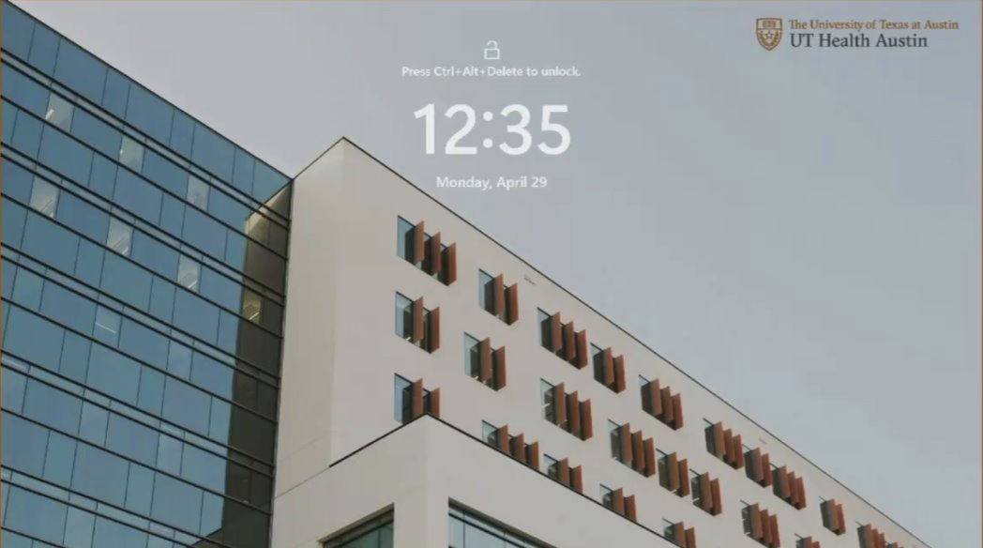
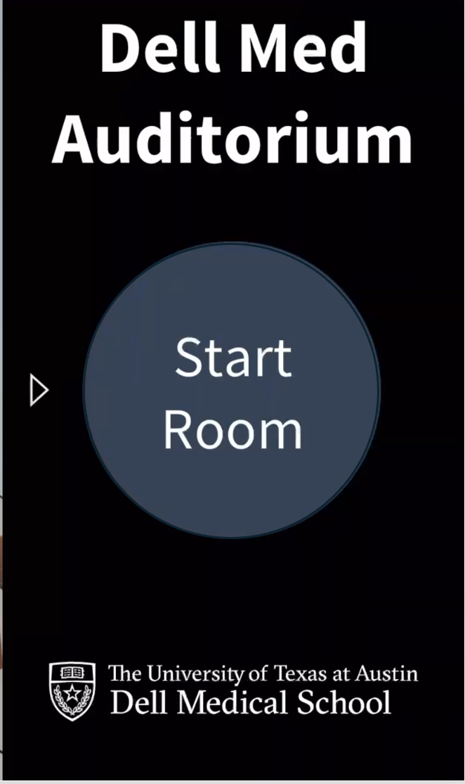
Tap the arrow to open the Crestron “Start Room” sidebar.

Slide 2
X
SLIDER CONTROL
Clicking on any of these inputs changes the content of this window to match what is being sent by the input selected.
A blue rectangle will always indicate which
input is being displayed.
X

Slide 3
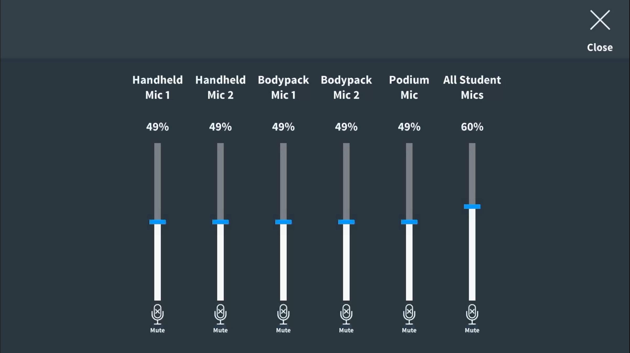
SLIDER CONTROLS
*Note:
The Overall Volume Control on the Crestron main panel override these settings when muted.

Slide 4
Clicking any of these camera names will produce the image that camera sees of the room with the last used tilt/pan settings. The selected camera is highlighted in blue.
Presets are available below. Use the “+” and “-” to Zoom in/out. Use the up/down arrows to tilt up/down. Use the left/right arrows to pan left/right.
X
Clicking any of these camera views will produce the image that camera or pair of cameras sees of the room with the last used tilt/pan settings in the arrangement drawn under the view title. The selected view is highlighted in blue.
X

Slide 5
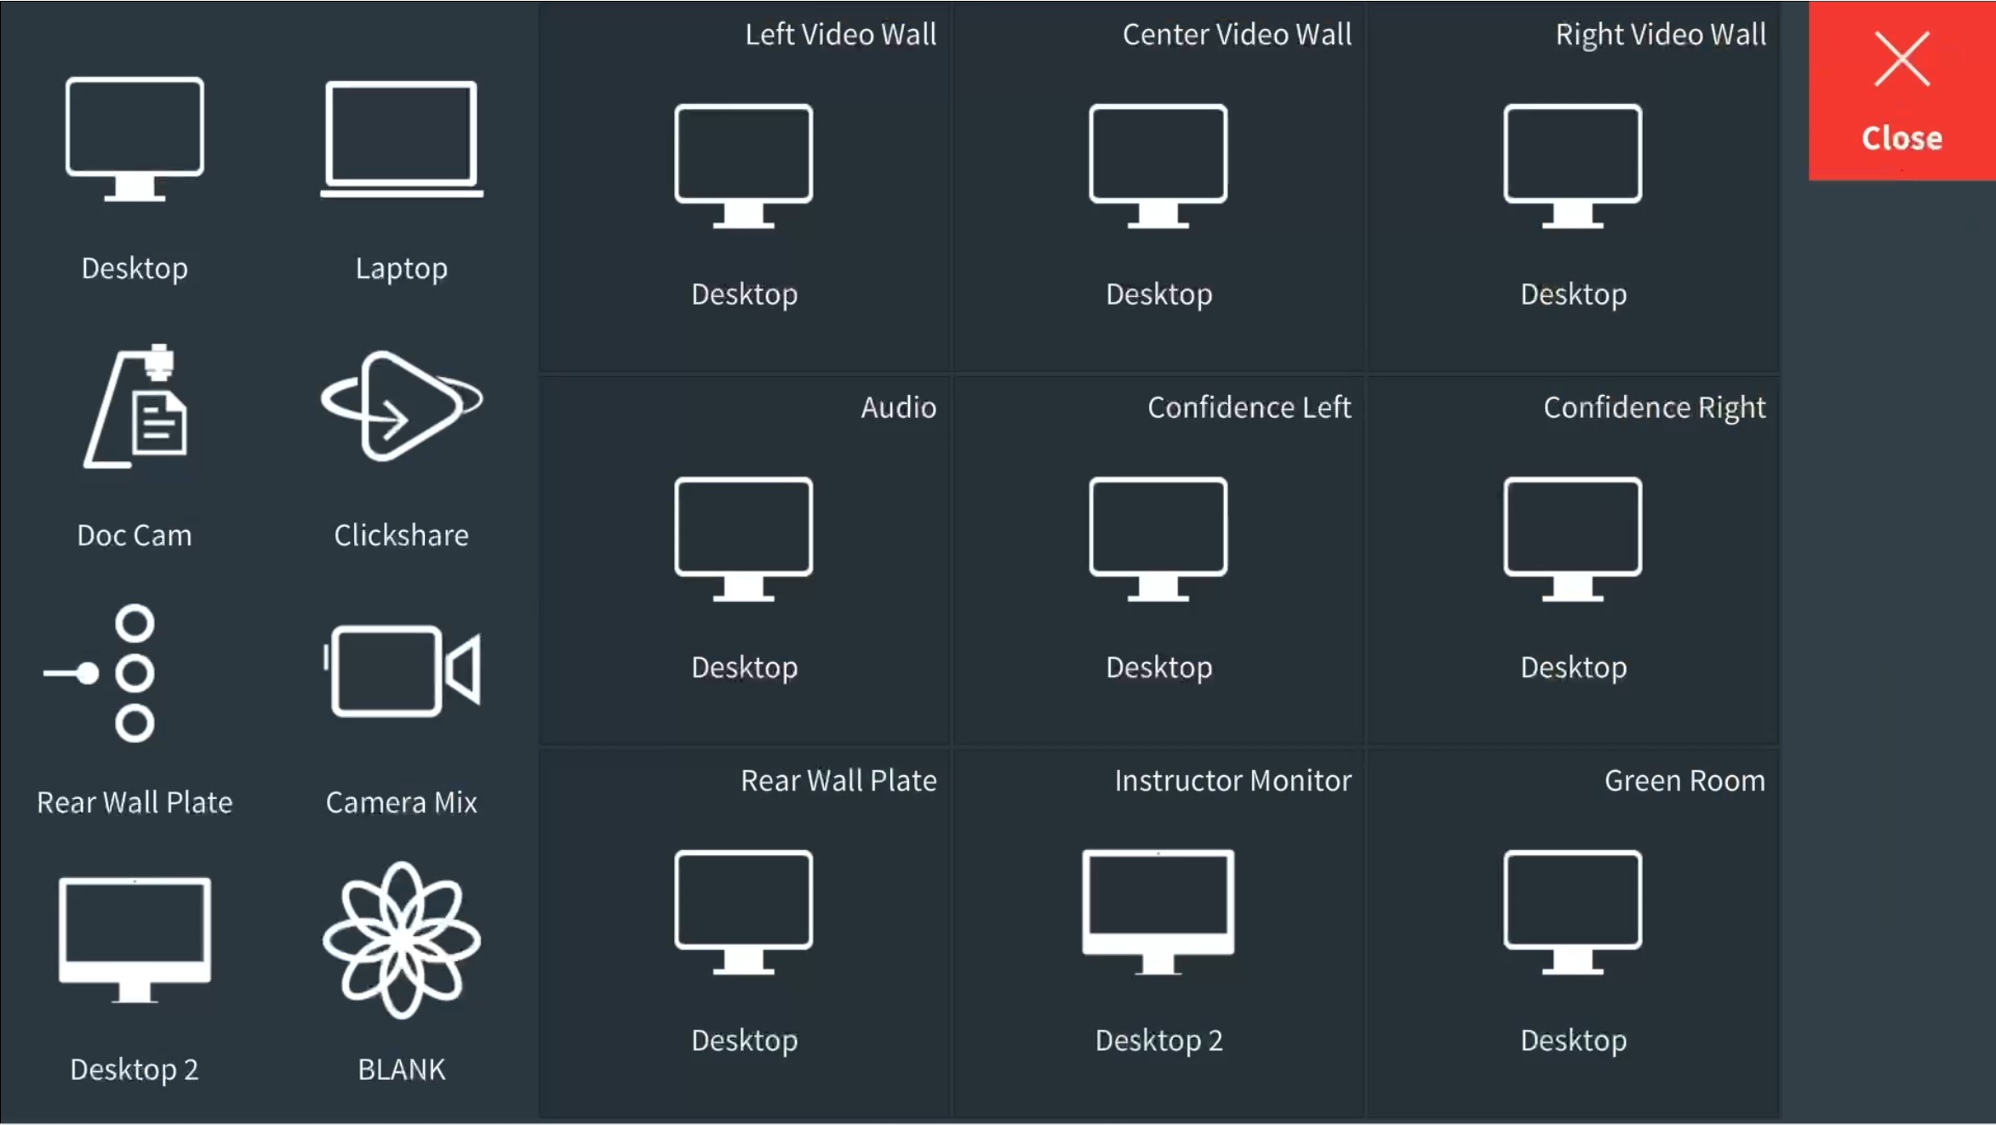
Inputs/Sources
On this slightly lighter section one finds all of the input sources available in the auditorium.
Displays
On this slightly darker section are all of the available displays for the auditorium, including the Green Room display. *Note: The Green Room must be enabled on the Crestron Home screen.
To arrange displays, simply grab an input source and drag it to the desired display. You can use different inputs with each on its own display or use a
single input to push to all displays – or something in between.

Slide 6
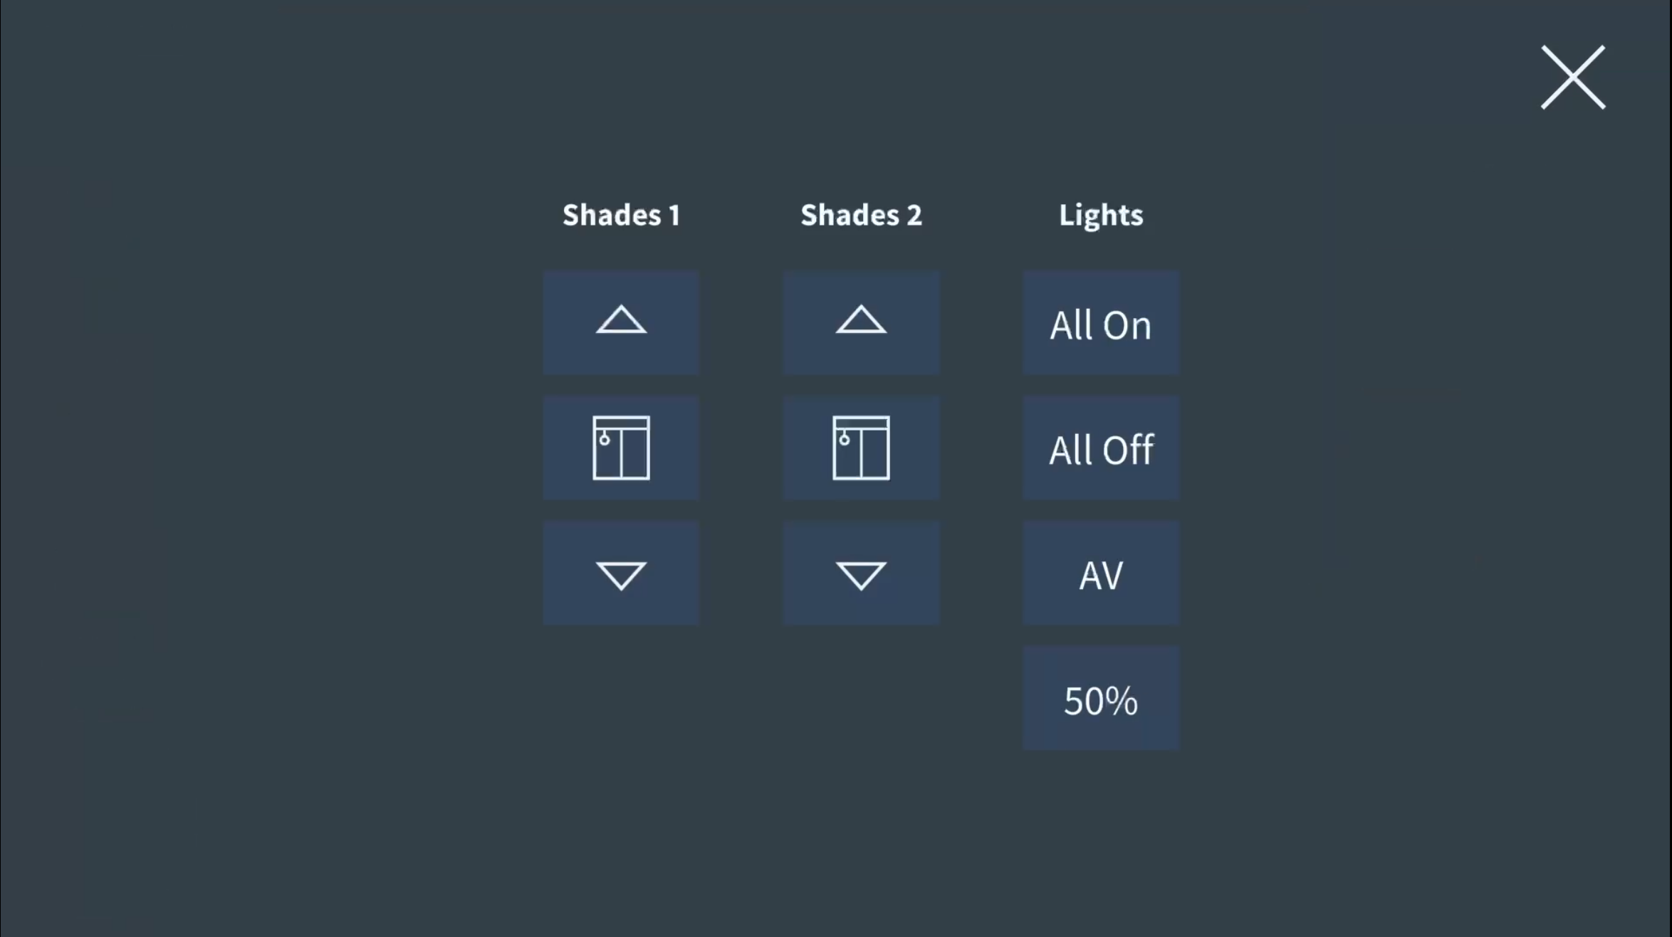
Outer shades up.
Inner shades up.
All lights on.
All lights off.
Inner shades down.
This button controls the lighting directly in front of the displays. Good for focusing on the screen, but not audio projection.
Outer shades down.
This button reduces all lights to 50%

