Slide 1
Home
Client: Texas State University
Status: In use
Audience: TXST faculty wanting to teach courses online and needing certification to do so (as per TXST)
Description: An eleven-module asynchronous course event that takes participants through all of the content they would have had if they had taken the original Foundations of/Advanced Online Course Design and Development. The original was reduced and converted to self-pace to the the Emergency Remote Teaching semester in Spring 2020 due to Covid 19.
This home page introduces the course overview/purpose, and instructions on how to get started. Shortcuts are provided for “Start Here”, “Modules”, and “Report a Problem”, which links users back to the ODEL business pages and contact info.

Slide 2
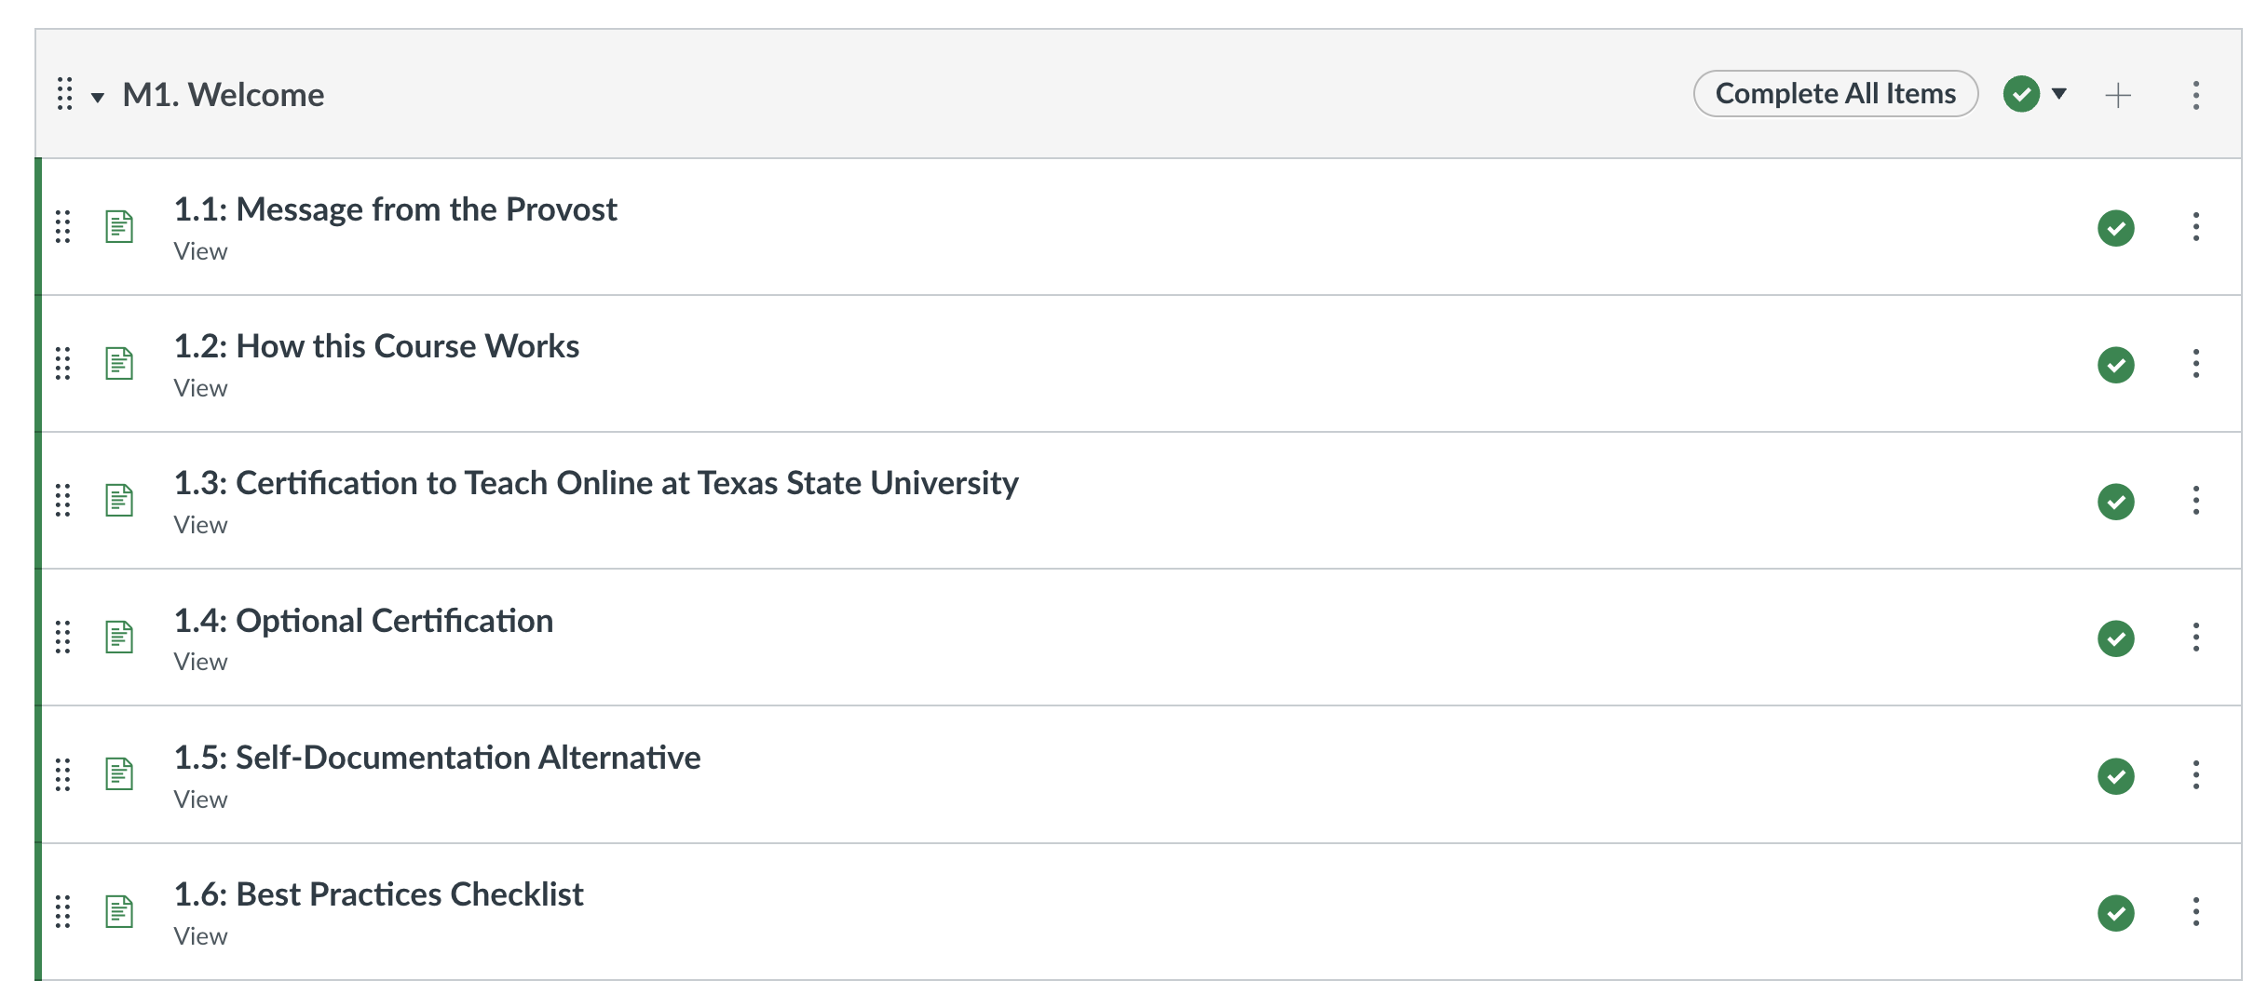
Home
Client: Texas State University
Status: In use
Audience: TXST faculty wanting to teach courses online and needing certification to do so (as per TXST)
Description: An eleven-module asynchronous course event that takes participants through all of the content they would have had if they had taken the original Foundations of/Advanced Online Course Design and Development. The original was reduced and converted to self-pace to the the Emergency Remote Teaching semester in Spring 2020 due to Covid 19.
The “Start Here” page includes supporting encouragement from the Provost, instructions on how the course words, explanations for why certification is needed, other ways to obtain certification, and introduction to the term “Best Practices Checklist”.

Slide 3
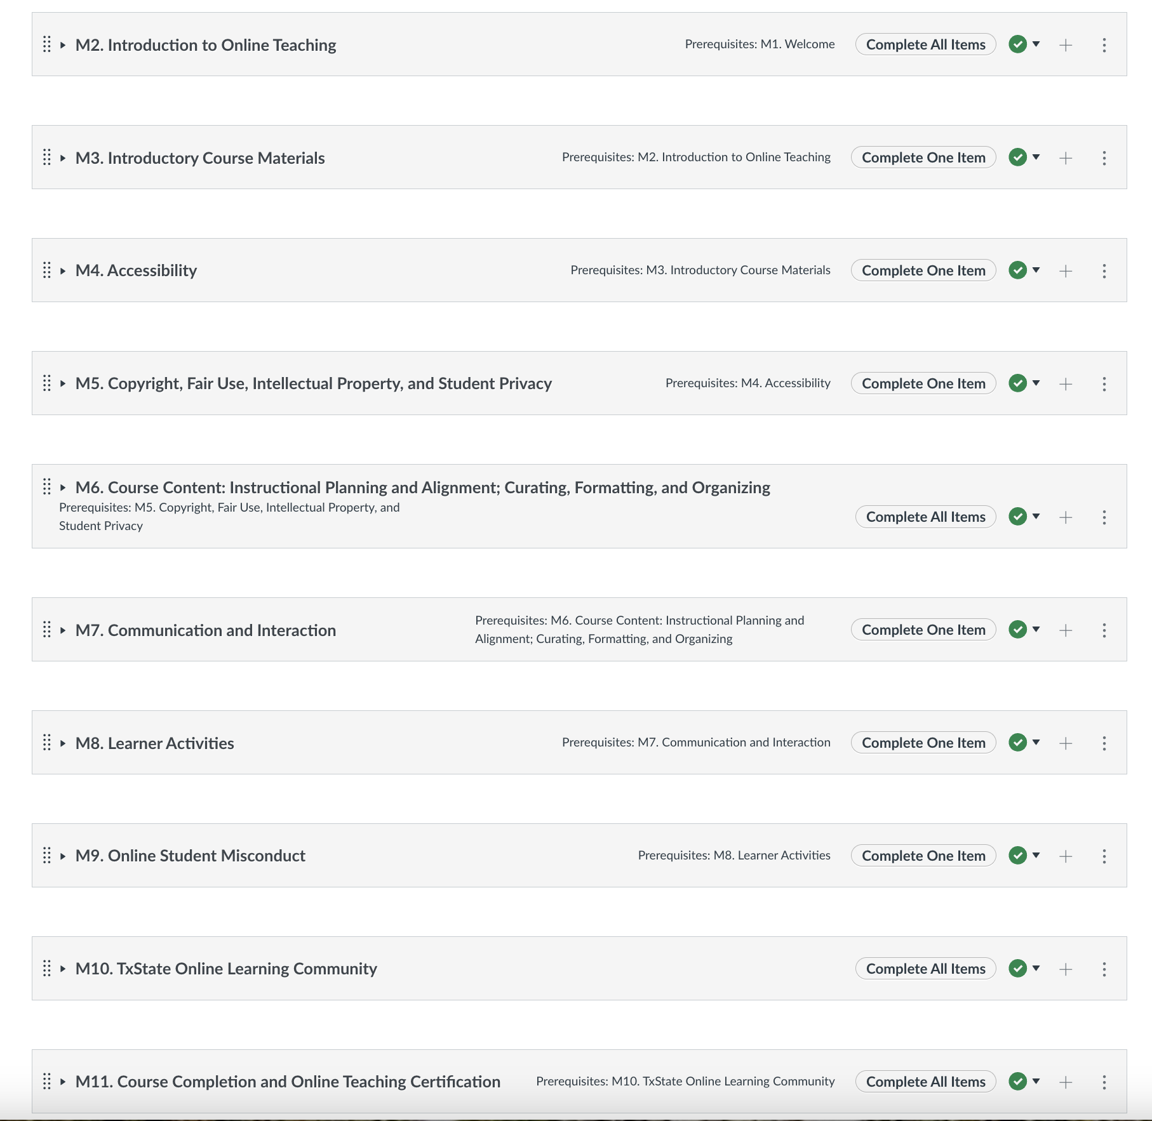
Home
Client: Texas State University
Status: In use
Audience: TXST faculty wanting to teach courses online and needing certification to do so (as per TXST)
Description: An eleven-module asynchronous course event that takes participants through all of the content they would have had if they had taken the original Foundations of/Advanced Online Course Design and Development. The original was reduced and converted to self-pace to the the Emergency Remote Teaching semester in Spring 2020 due to Covid 19.
Each of the remaining modules are divided by broad categories related to online course design, ending in module 11 where participants acknowledge their completion of the course. This actually serves to notify “instructors” (or the IDs monitoring the course to provide certification. These were not set as micro-credentials as of yet, but rather participants received digital copies of certificates.
Each module required the completion of all items to progress.

Slide 4
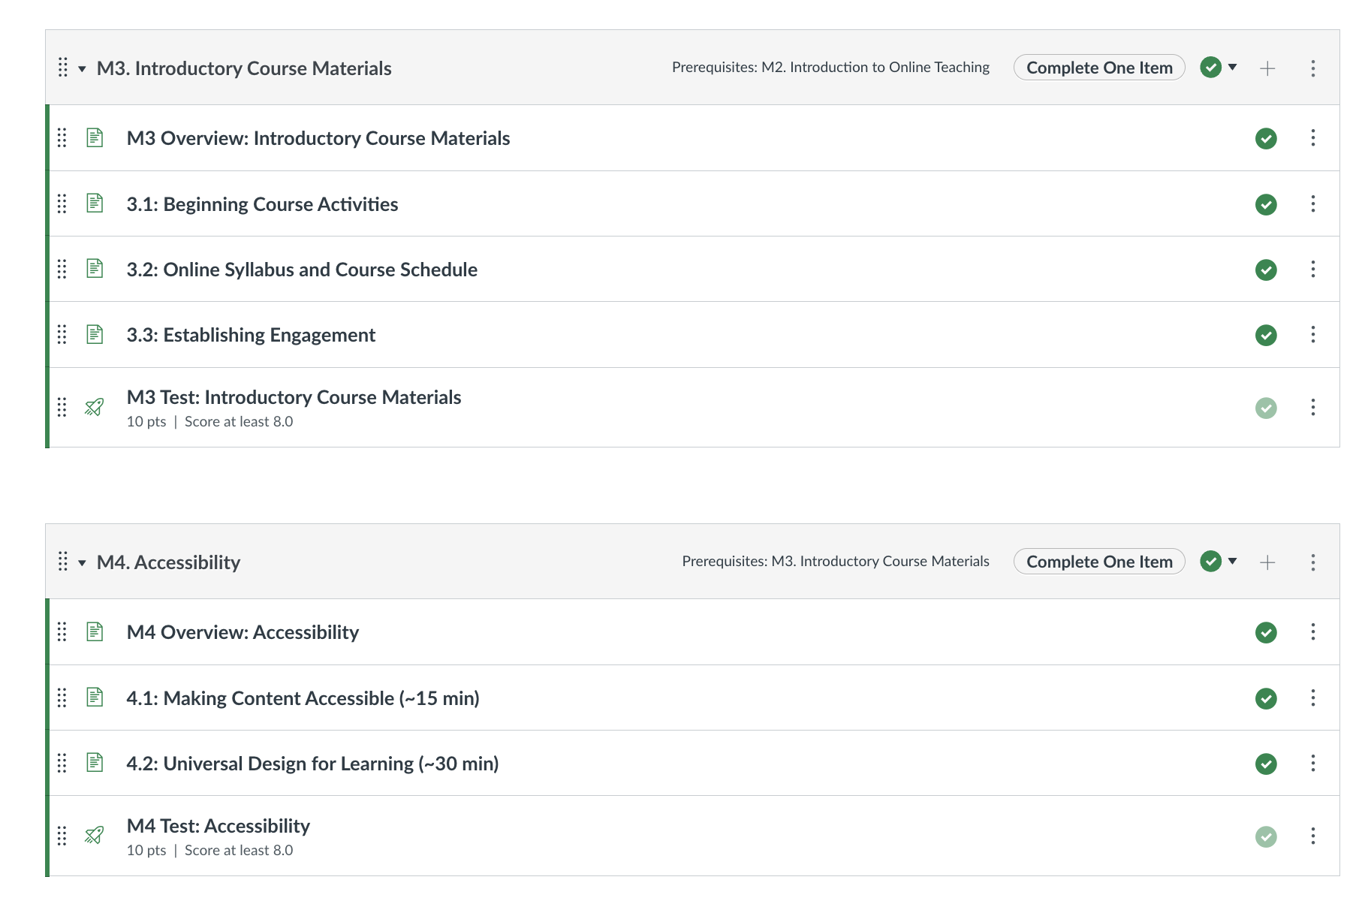
Home
Client: Texas State University
Status: In use
Audience: TXST faculty wanting to teach courses online and needing certification to do so (as per TXST)
Description: An eleven-module asynchronous course event that takes participants through all of the content they would have had if they had taken the original Foundations of/Advanced Online Course Design and Development. The original was reduced and converted to self-pace to the the Emergency Remote Teaching semester in Spring 2020 due to Covid 19.
Each module contains several topic specific content and a quiz. Participants must get an 80 to move on. This requirement was set by upper administration.

Slide 5
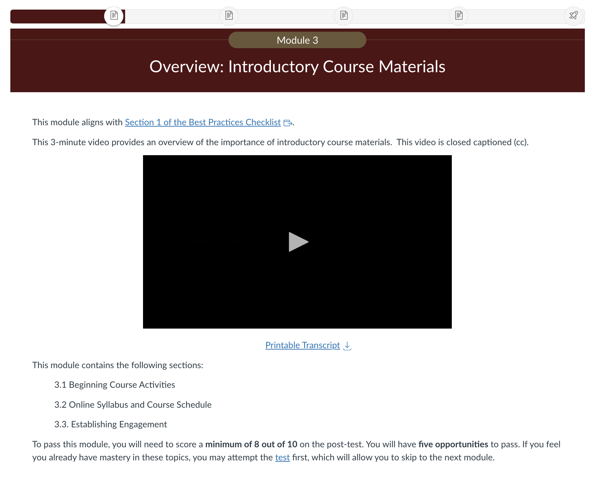
Home
Client: Texas State University
Status: In use
Audience: TXST faculty wanting to teach courses online and needing certification to do so (as per TXST)
Description: An eleven-module asynchronous course event that takes participants through all of the content they would have had if they had taken the original Foundations of/Advanced Online Course Design and Development. The original was reduced and converted to self-pace to the the Emergency Remote Teaching semester in Spring 2020 due to Covid 19.
Individual module lessons began with an overview page, which a very short video, and introduction to the content. Videos always include transcripts or closed captions.

Slide 6
Home
Client: Texas State University
Status: In use
Audience: TXST faculty wanting to teach courses online and needing certification to do so (as per TXST)
Description: An eleven-module asynchronous course event that takes participants through all of the content they would have had if they had taken the original Foundations of/Advanced Online Course Design and Development. The original was reduced and converted to self-pace to the the Emergency Remote Teaching semester in Spring 2020 due to Covid 19.
Subsequent topic specific pages include the pertinent objectives, a blurb, and a presentation or video. Each page in a module includes a progress navigation bar at the top. This presentation is offered as a downloadable, accessible Powerpoint, but also available as slides in an image carousel for quickly seeing the slides.

Slide 7
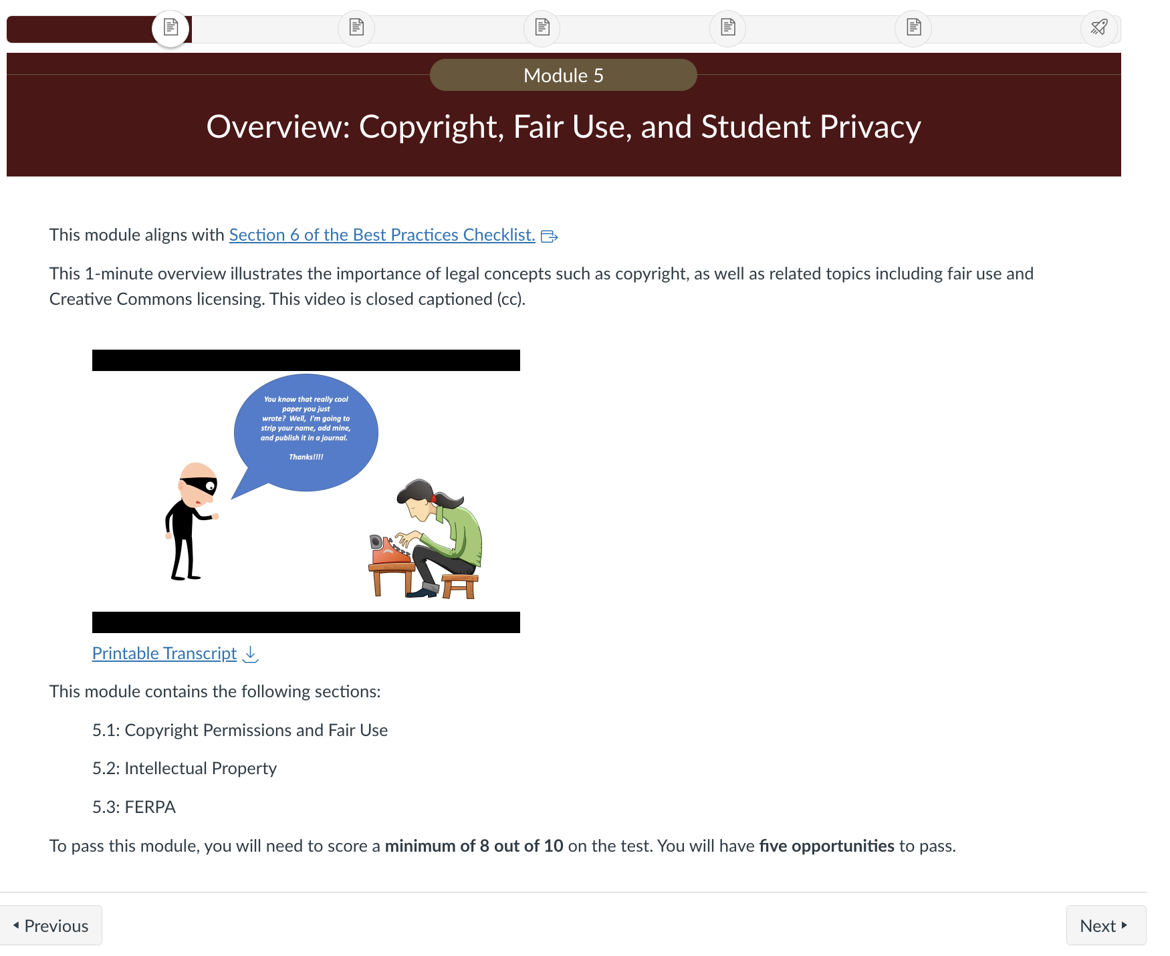
Home
Client: Texas State University
Status: In use
Audience: TXST faculty wanting to teach courses online and needing certification to do so (as per TXST)
Description: An eleven-module asynchronous course event that takes participants through all of the content they would have had if they had taken the original Foundations of/Advanced Online Course Design and Development. The original was reduced and converted to self-pace to the the Emergency Remote Teaching semester in Spring 2020 due to Covid 19.
Notice that each overview page shows aligned with the Best Practices Checklist (BPC). This is an institutional checklist that cross-references multiple regional and federal recourses to create a comprehensive list for making good online course.

Slide 8
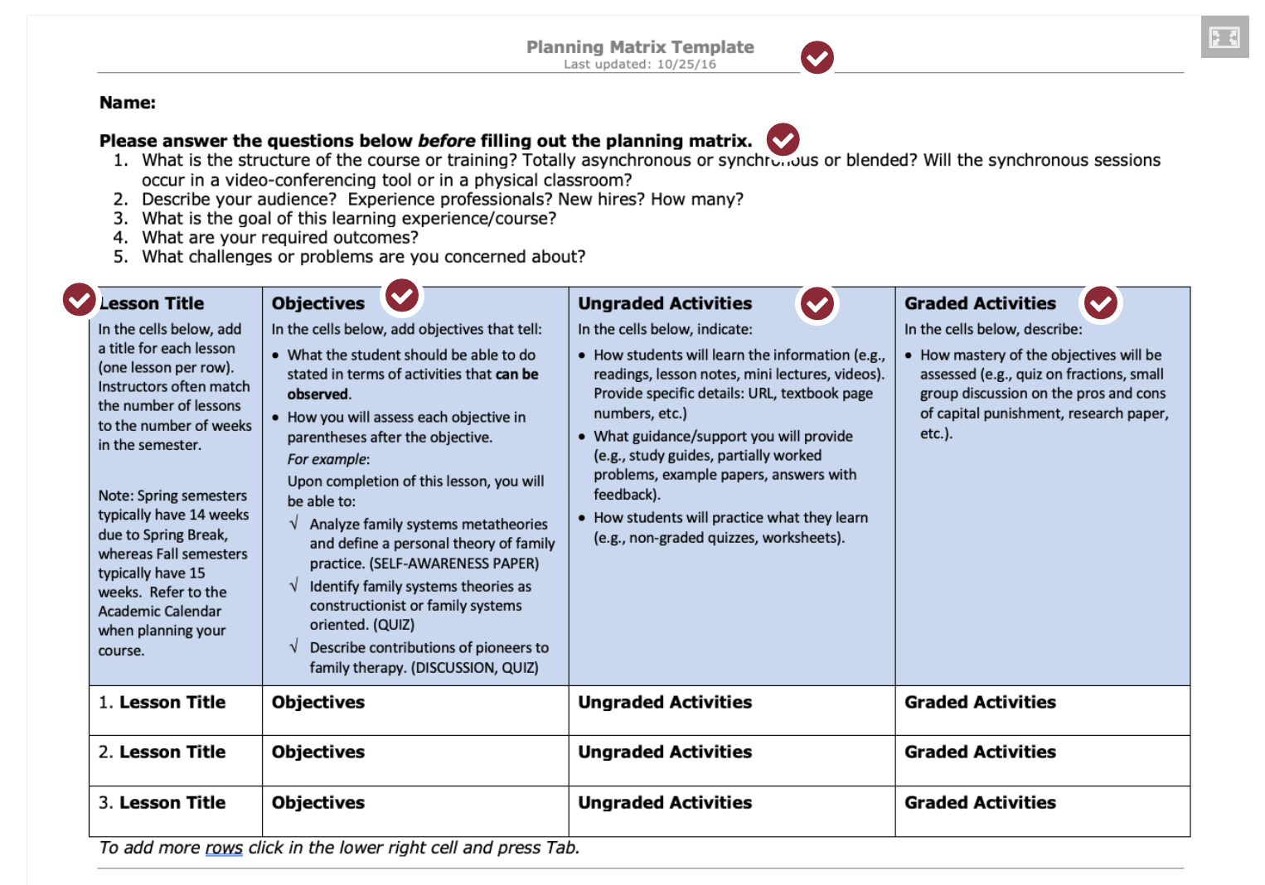
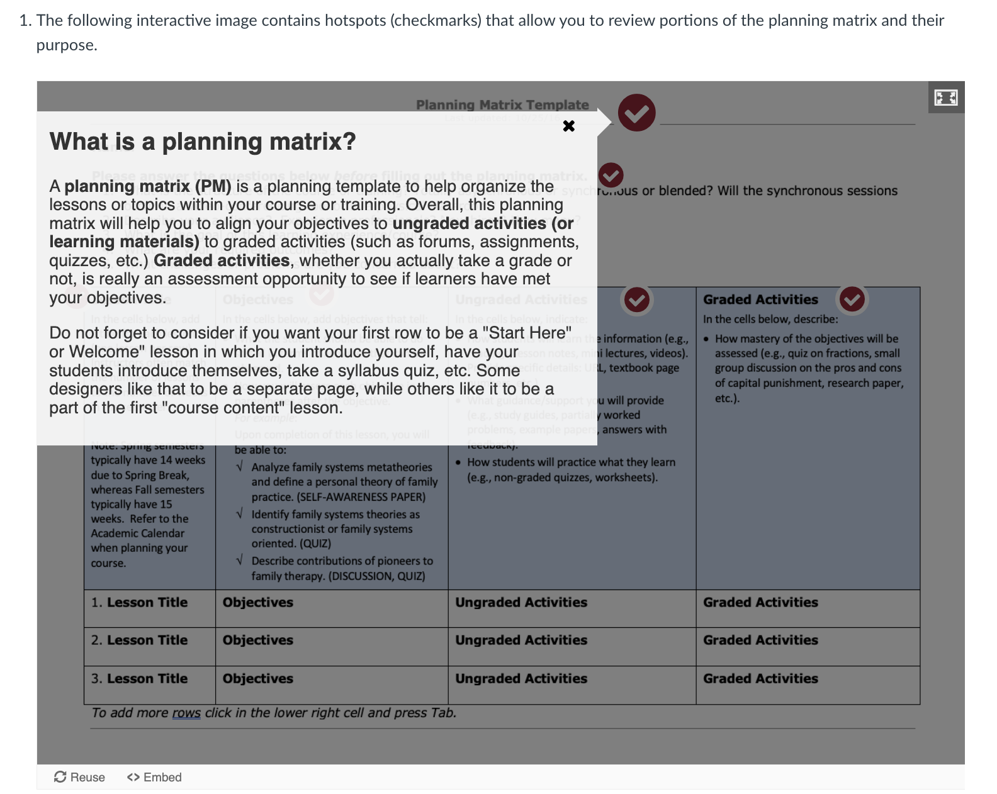
Home
Client: Texas State University
Status: In use
Audience: TXST faculty wanting to teach courses online and needing certification to do so (as per TXST)
Description: An eleven-module asynchronous course event that takes participants through all of the content they would have had if they had taken the original Foundations of/Advanced Online Course Design and Development. The original was reduced and converted to self-pace to the the Emergency Remote Teaching semester in Spring 2020 due to Covid 19.
The course also includes several information interactives, like this Planning Matrix images. Hotspots tell participants what each section is for or provides further explanation.

Slide 9
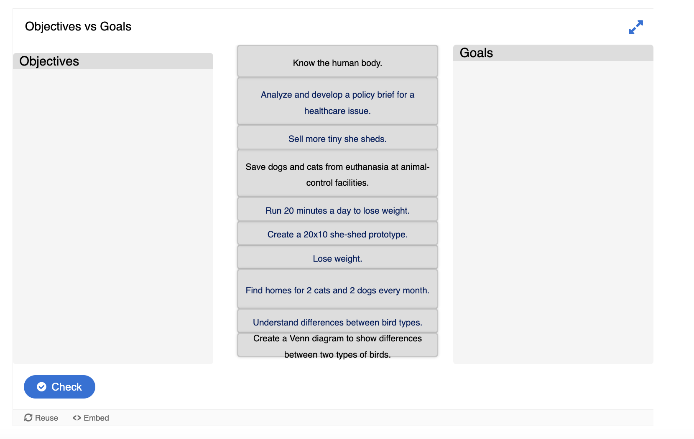
Home
Client: Texas State University
Status: In use
Audience: TXST faculty wanting to teach courses online and needing certification to do so (as per TXST)
Description: An eleven-module asynchronous course event that takes participants through all of the content they would have had if they had taken the original Foundations of/Advanced Online Course Design and Development. The original was reduced and converted to self-pace to the the Emergency Remote Teaching semester in Spring 2020 due to Covid 19.
The course also includes opportunities for practices, such as this exercise to identify goals verses objectives.

Slide 10
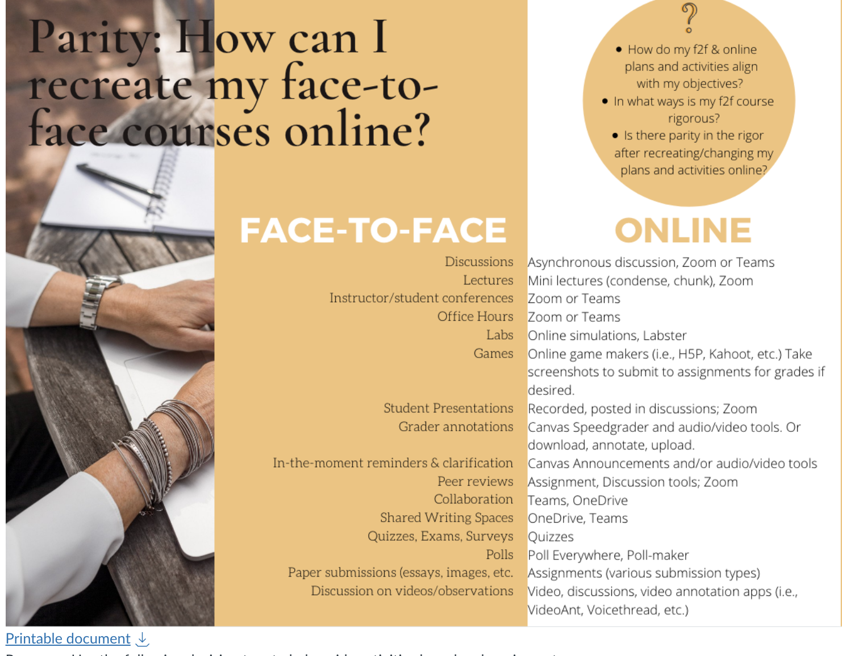
Home
Client: Texas State University
Status: In use
Audience: TXST faculty wanting to teach courses online and needing certification to do so (as per TXST)
Description: An eleven-module asynchronous course event that takes participants through all of the content they would have had if they had taken the original Foundations of/Advanced Online Course Design and Development. The original was reduced and converted to self-pace to the the Emergency Remote Teaching semester in Spring 2020 due to Covid 19.
The course also infographic like documents, displayed as images, but downloadable as accessible documents for screenreaders.

Slide 11
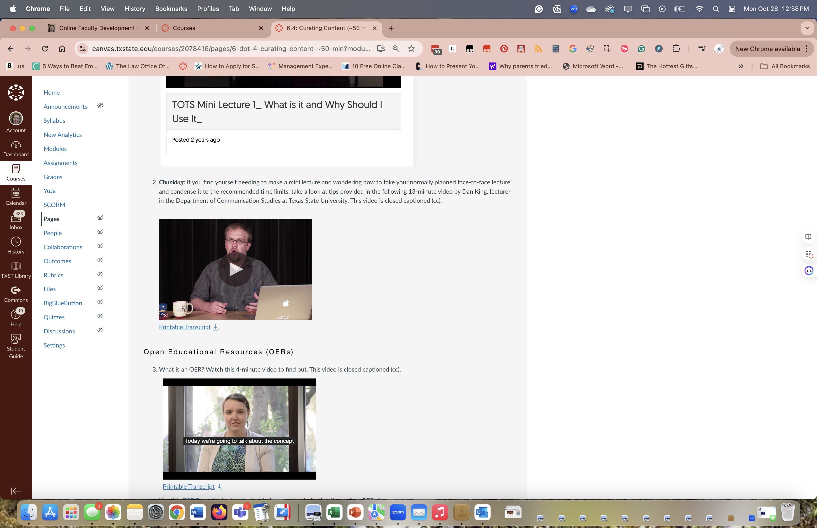
Home
Client: Texas State University
Status: In use
Audience: TXST faculty wanting to teach courses online and needing certification to do so (as per TXST)
Description: An eleven-module asynchronous course event that takes participants through all of the content they would have had if they had taken the original Foundations of/Advanced Online Course Design and Development. The original was reduced and converted to self-pace to the the Emergency Remote Teaching semester in Spring 2020 due to Covid 19.
The design and development of this course was led by me, in terms of guiding instructional designers and assigning content, but the whole thing was a beautiful, collaborative effort. All IDs created instructional videos, handouts, etc. and we utilized several experienced faculty members to provide insight as well.

Slide 12
Home
Client: Texas State University
Status: In use
Audience: TXST faculty wanting to teach courses online and needing certification to do so (as per TXST)
Description: An eleven-module asynchronous course event that takes participants through all of the content they would have had if they had taken the original Foundations of/Advanced Online Course Design and Development. The original was reduced and converted to self-pace to the the Emergency Remote Teaching semester in Spring 2020 due to Covid 19.
One of the goals we had in designing this course was to chunk information. We really wanted to see how participants preferred to see it: Single video with bookmarks (such as seen here), and playlist of several 5-7 minute videos, or a series of 5-7 minute videos embedded linearly. The last was not well received, but both of the first two options were.

Slide 13
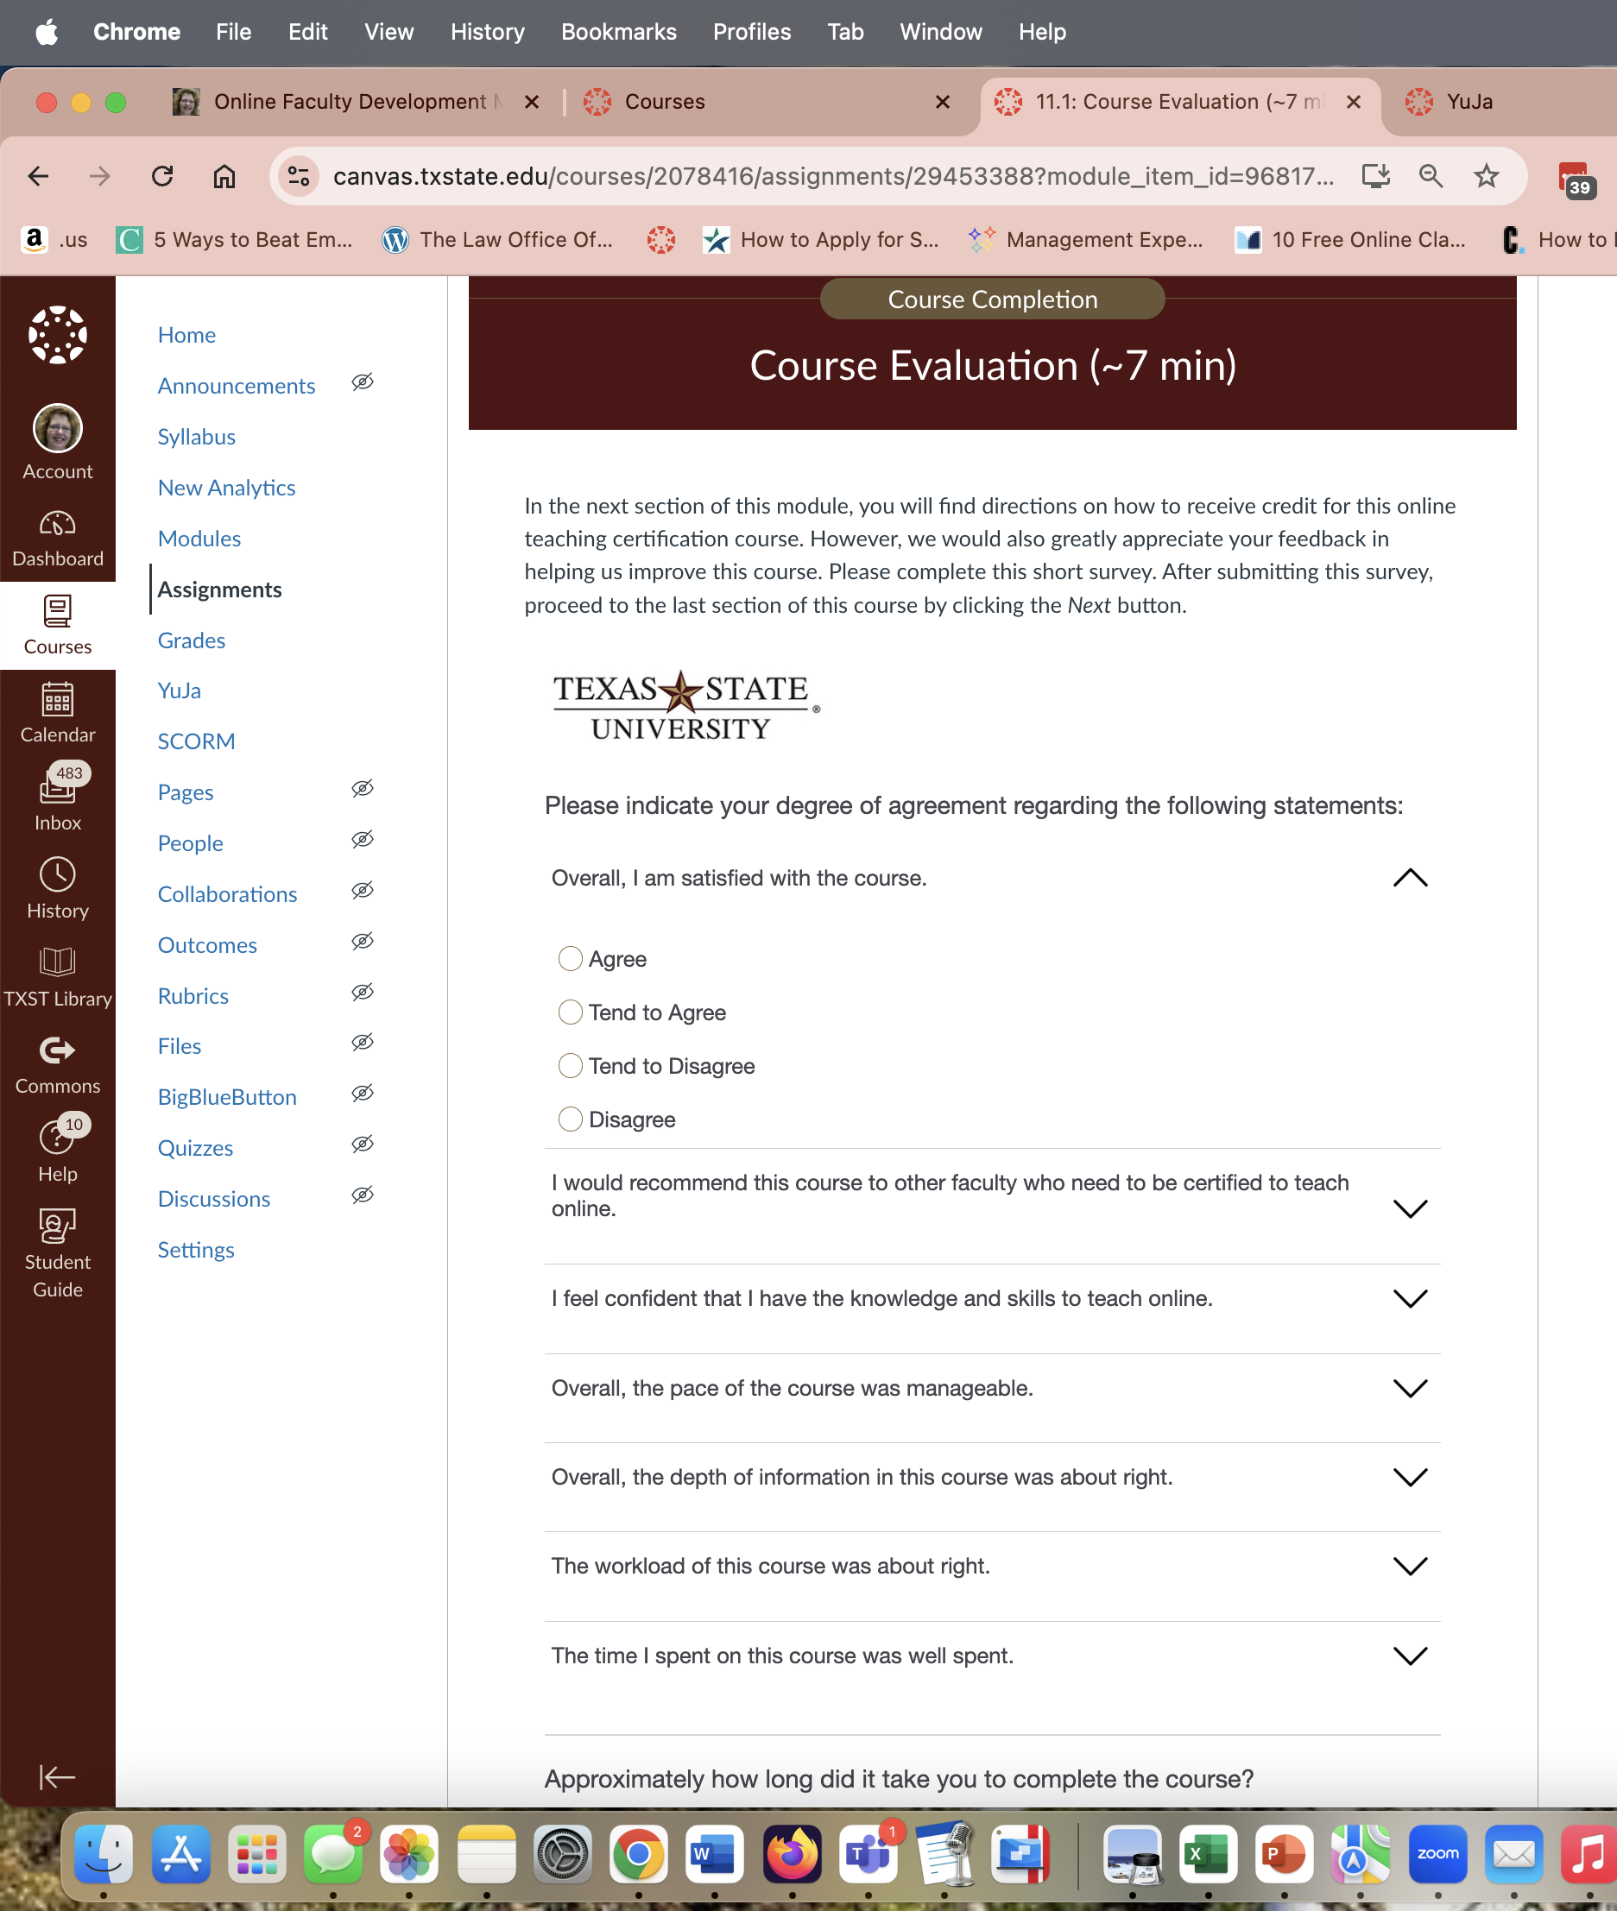
Home
Client: Texas State University
Status: In use
Audience: TXST faculty wanting to teach courses online and needing certification to do so (as per TXST)
Description: An eleven-module asynchronous course event that takes participants through all of the content they would have had if they had taken the original Foundations of/Advanced Online Course Design and Development. The original was reduced and converted to self-pace to the the Emergency Remote Teaching semester in Spring 2020 due to Covid 19.
Each participant was asked to submit a Participation Perception Survey to drive further iterations and possible research ideas.

Slide 14
Home
Client: Texas State University
Status: In use
Audience: TXST faculty wanting to teach courses online and needing certification to do so (as per TXST)
Description: An eleven-module asynchronous course event that takes participants through all of the content they would have had if they had taken the original Foundations of/Advanced Online Course Design and Development. The original was reduced and converted to self-pace to the the Emergency Remote Teaching semester in Spring 2020 due to Covid 19.

