Slide 1
UDL for DEIA
Michelle Read, Ph.D.

Slide 4
In what ways did you feel “different” in school?
{Insert Poll Everywhere}

Slide 5
Stereotypes

Slide 6
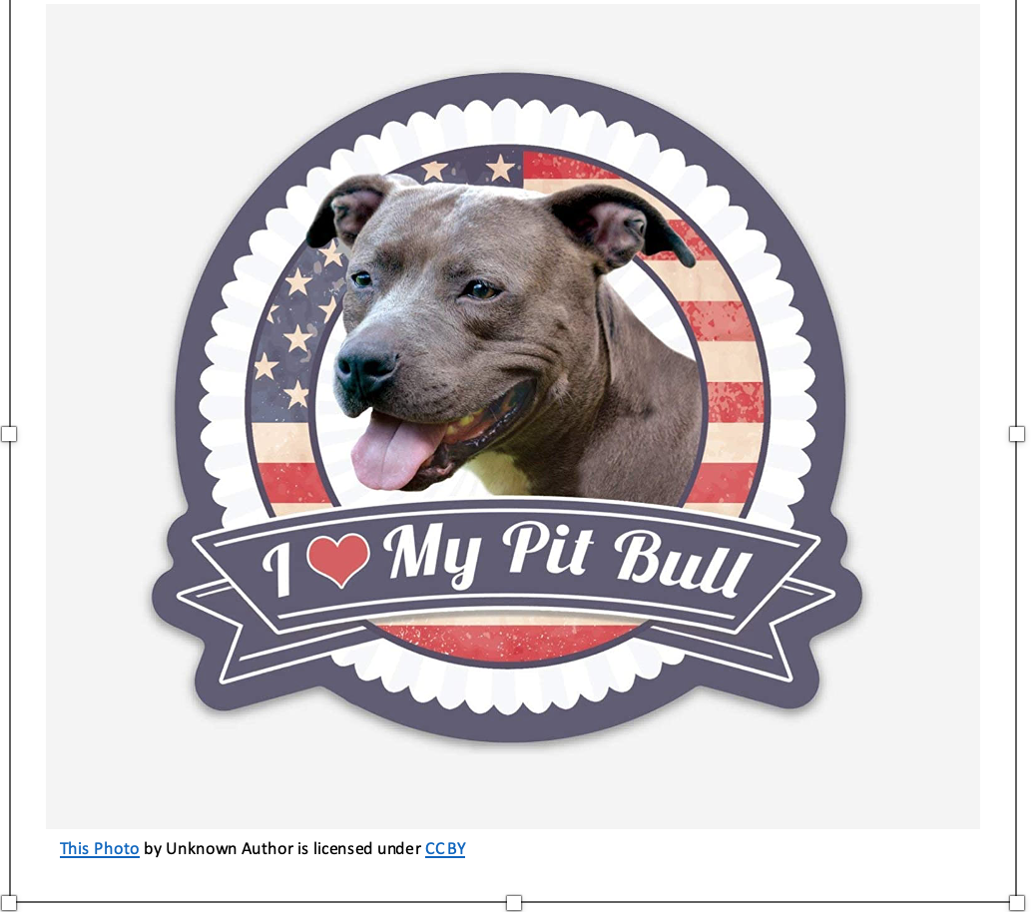
Stereotype: Pitbulls like to fight.
That simply isn't a true statement. It implies that 'all’ Pitbulls like to fight. I think we all know, and maybe love a Pitbull, for whom this stereotype doesn’t fit.
So, assuming dogs could talk, why would I ask a Pitbull, who may or may not be a fighter, why Pitbulls like to fight?

Slide 7
Belonging

Slide 8
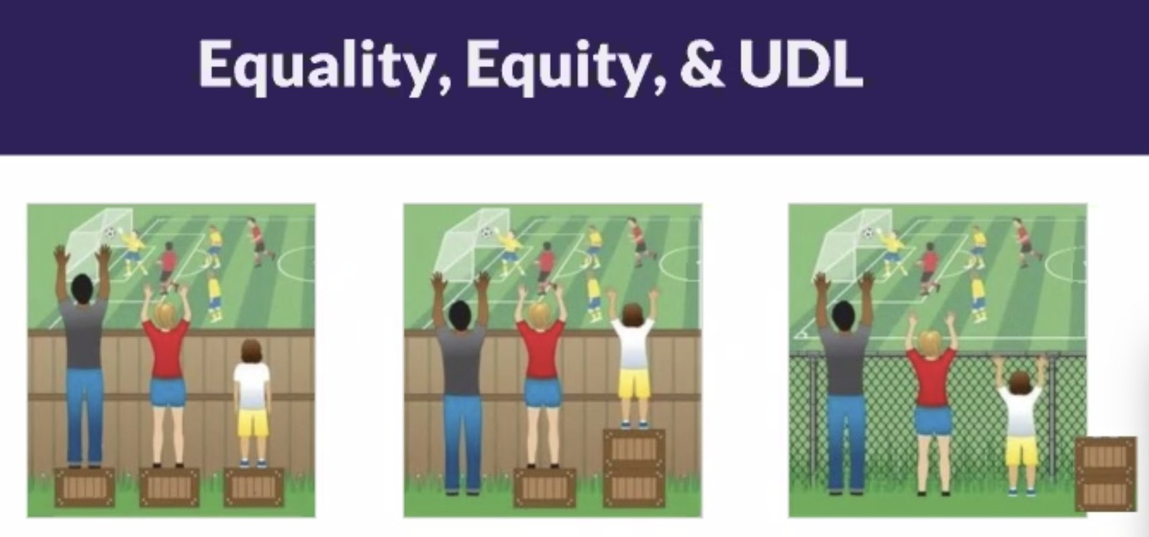
Equality ---------------------------------- Everyone gets the same box to stand on.
Equity ---------------------------------- Everyone gets the box size they need to see the game.
UDL --------------------------------------------- Boxes are not needed because barriers have been removed.

Slide 9
Universal Design Learning (UDL) is an individualized style of classroom instruction where one teacher uses a variety of teaching techniques to best serve different learning styles.
~ Insight Neuropsychology.

Slide 11
What are “Learning Styles”? (Not to be confused with Gardner’s Multiple Intelligences!)

Slide 13
How does UDL and Accessibility go together? Adding the “A” to DEI.
Physical limitations
Cognitive barriers – learning disabilities
Mental/Emotional
Situational/Environmental
Wheelchair, cane, blindness, deafness, color-blindness, limited use of limbs.
Dyslexia, dysgraphia, etc.
ADD/ADHD
Autism spectrum
Processing (in or out) disorders
Trauma, PTSD
Accommodations often include:
Chronic or situational depression
Anxiety
Low self-esteem due to personally identifying characteristics
Possible accommodations: Trigger warnings. If appropriate, provide assignment alternatives, encourage diverse opinions, make your class a “safe space”.
Outbursts may be due to physical conditions, such as Tourrette’s, Autism, etc.
Homelessness
Lack of support
First Gen
Accommodations may include longer duration for testing (often time & a half), oral test administration, longer time for assignments or projects, assignment alternatives/choice.
Possible accommodations: Make courses mobile ready. Provide additional time to access a computer.

Slide 14
How does UDL and Accessibility go together? Adding the “A” to DEI.
Preparing for student accommodations
IS removing barriers.
Don’t forget to check how your course looks and performs on a mobile device.
Be Proactive!
Design for DEIA with UDL!
Remember - remove the barriers.
Use document styling.
Use Alt Text.
Identify header rows in tables.
Caption.
Run UDOIT & Accessibility Checkers.
Use contextual links.
Ensure e-textbooks, 3rd party sites, forms, interactive tools, etc. are accessible.

